Slide 1
PC Building
UBMS Stem Experience: Jurassic Park

Slide 2
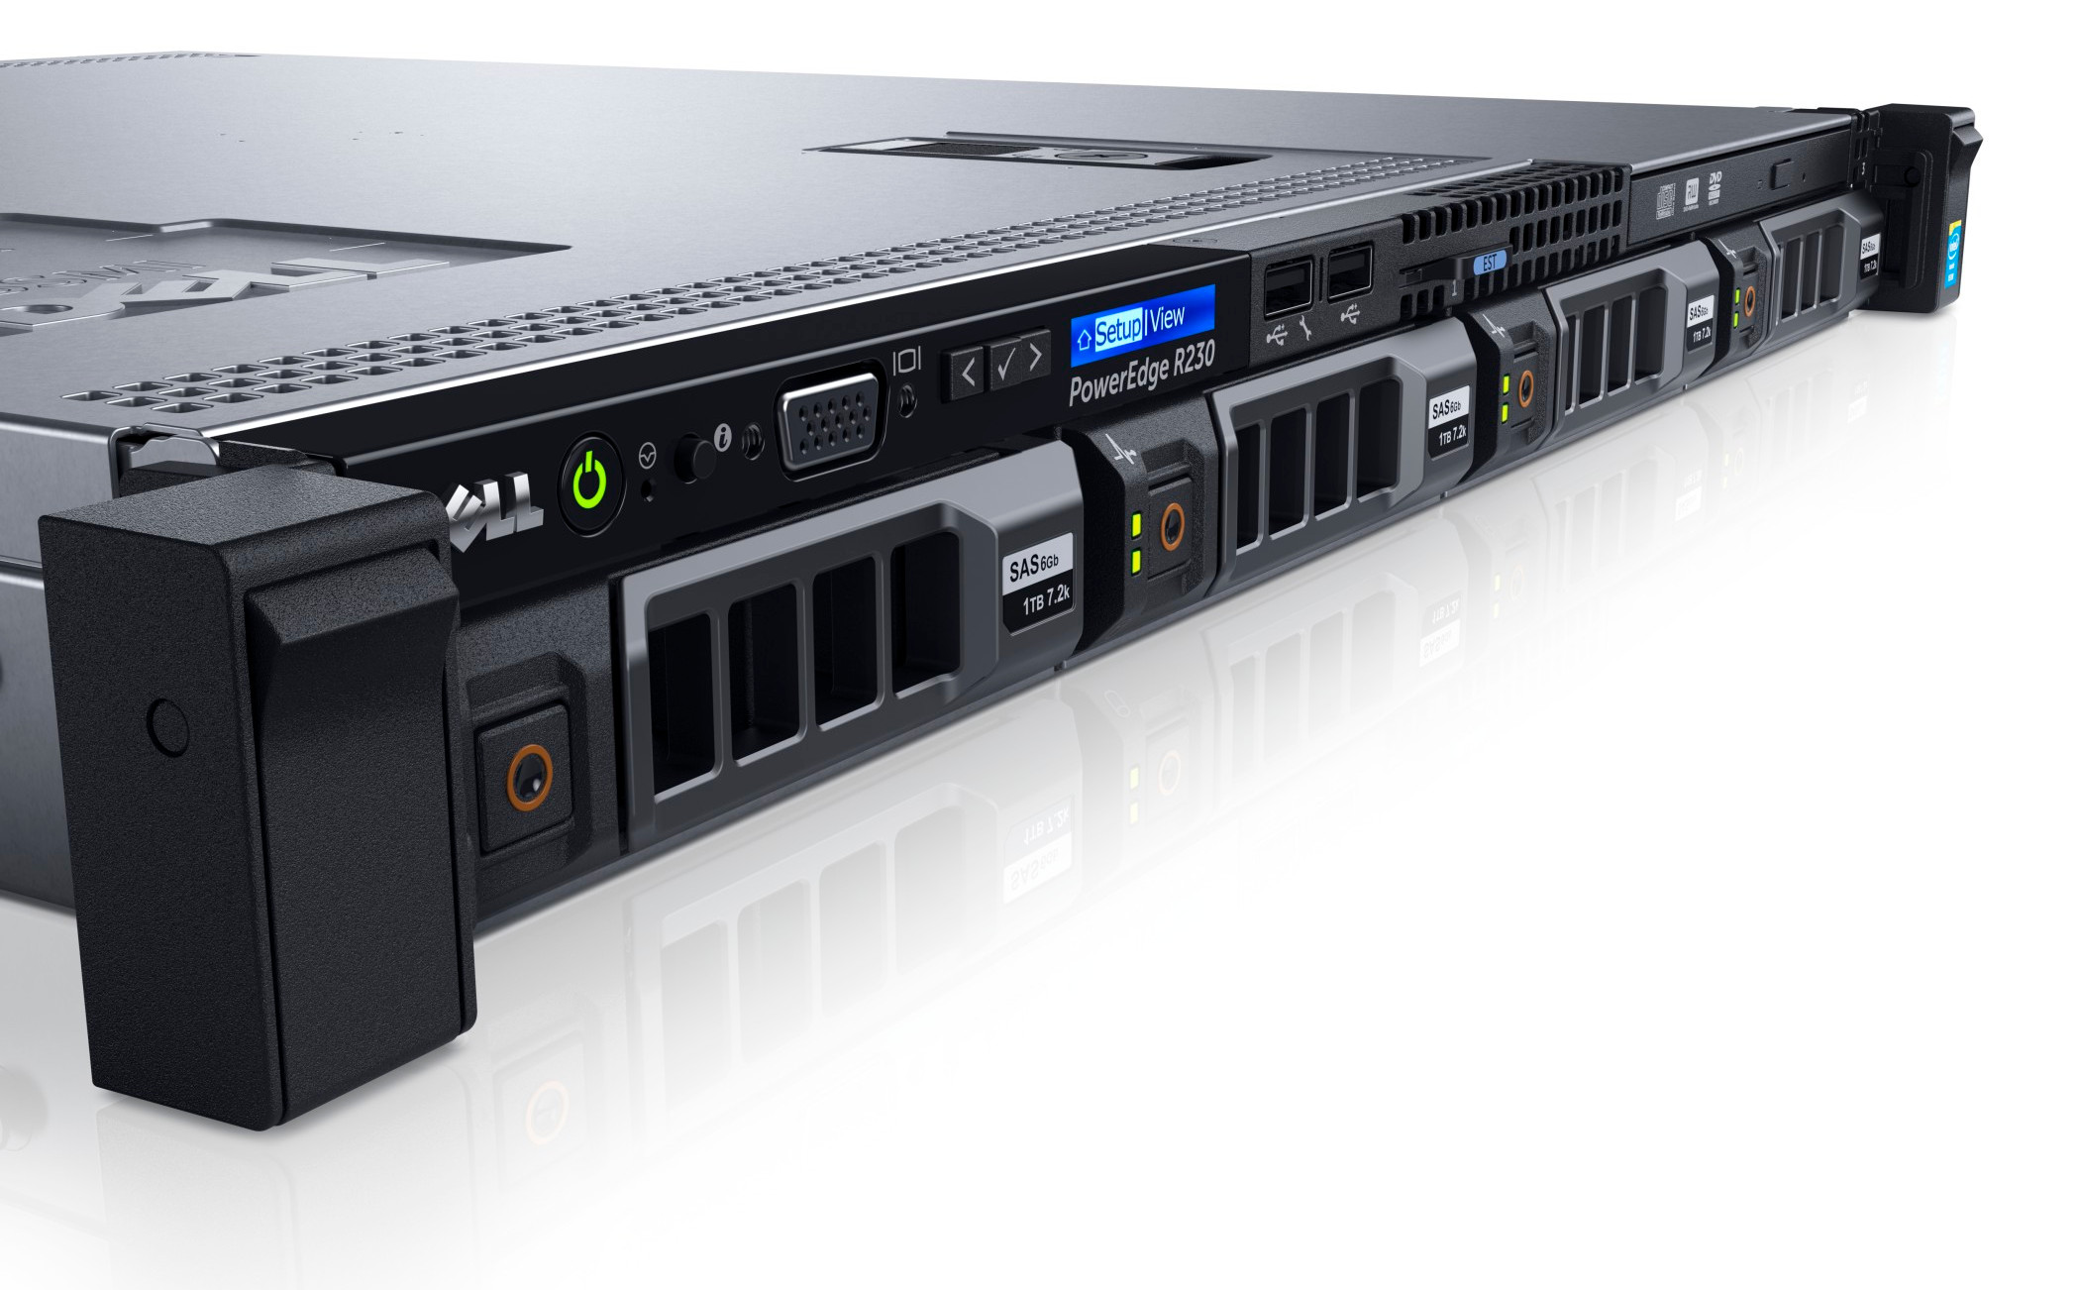
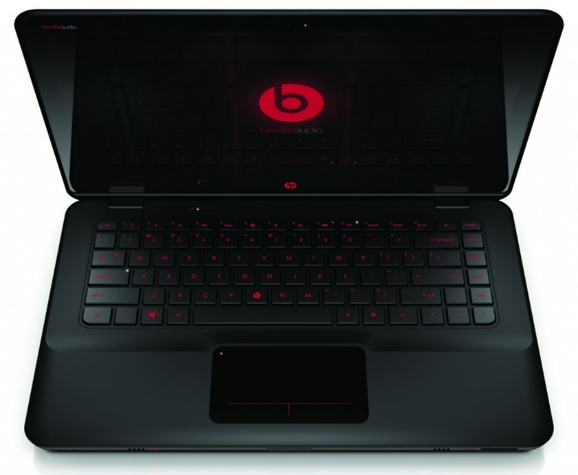
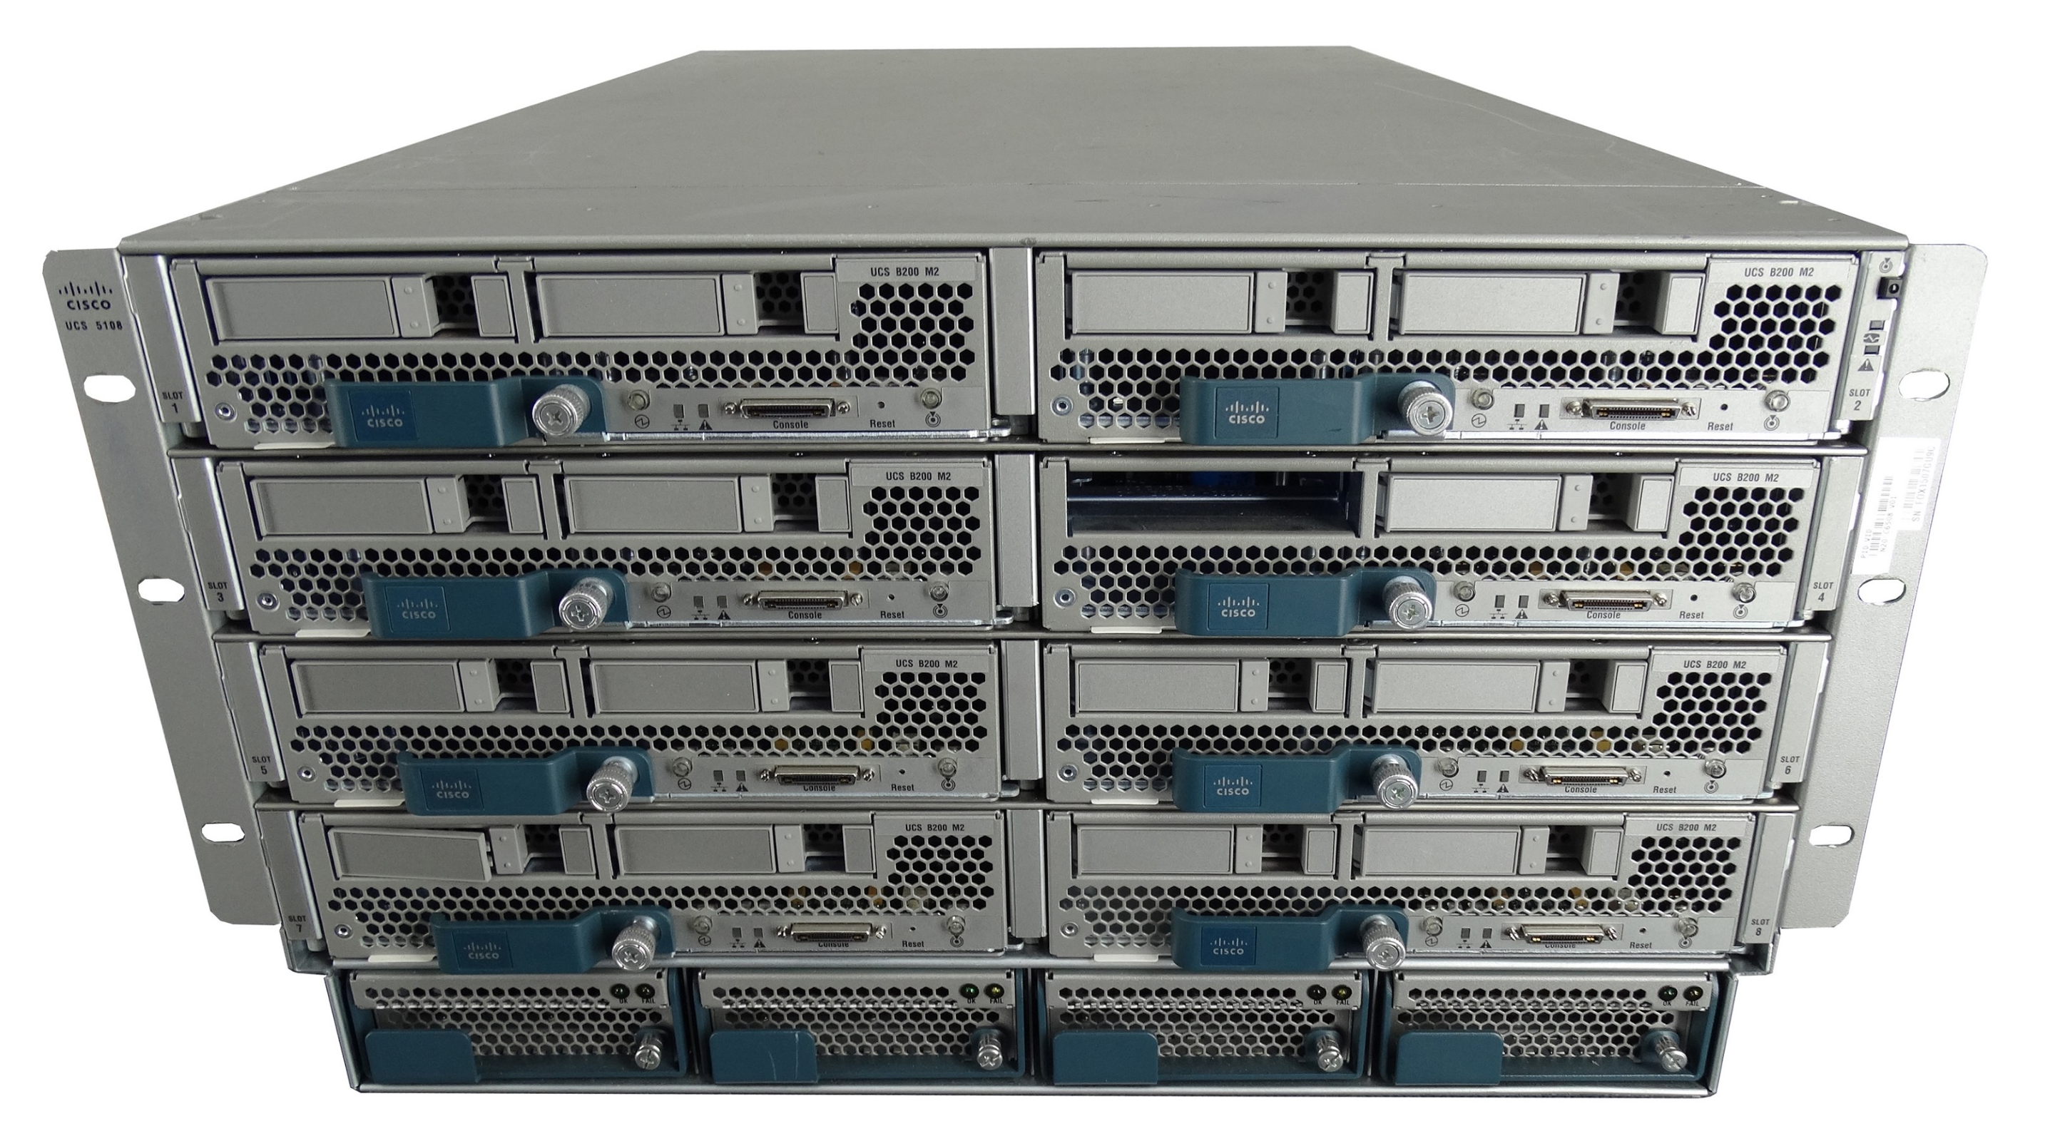
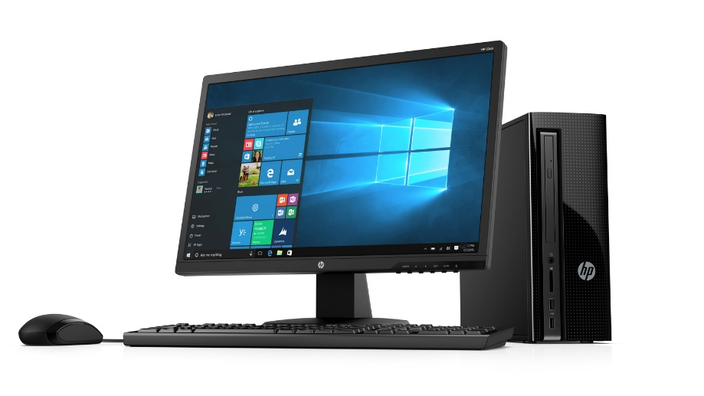
Computers
Servers
Personal Computers
Notes:
When we think about a computer, perhaps the first thing that comes to mind is the traditional hardware that we are used to seeing everyday. That is, the normal desktop unit or the laptop and if you are more familiar with networking then we might also consider server hardware.

Slide 3
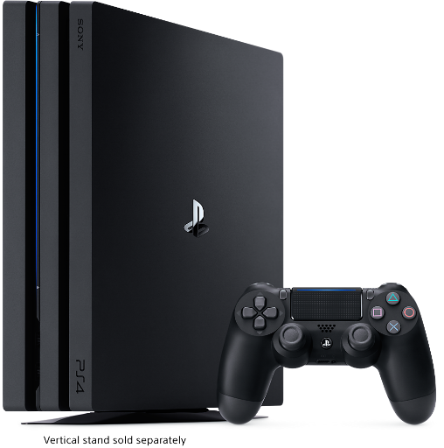


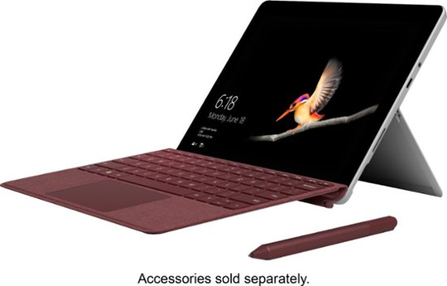
Also Computers
Game Systems
Portable Devices
Notes:
In reality, a computer can come in many form factors, that is, a different shape or presentation as well as in different sizes, such as gaming consoles, tablets and smartphones. It is important to keep in mind that because of their form factors, you can find a computer in many devices that may not come to mind right away. With todays current technology, we can find a computer in refrigerators, microwaves, cars, airplanes, and in many other devices and gadgets. We are always wanting more powerful and smaller devices and due to technological advancements, it is possible.

Slide 4
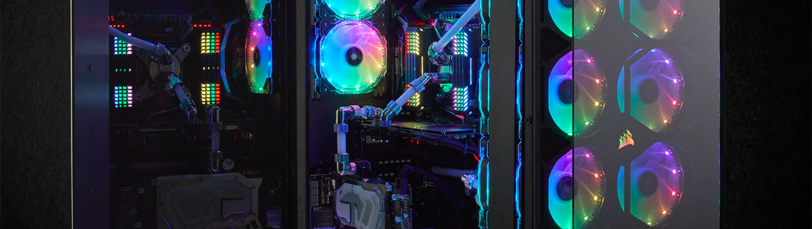
System Cases

Slide 5

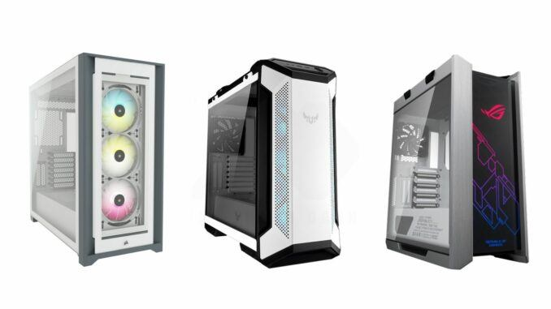
System Case / Chassis
Notes:
Provides protection, organization, and airflow for PC components
Includes status displays and buttons for powering on and resetting PC
Comes in many different shapes and sizes
Should be purchased with the components in mind to ensure it can fit everything

Slide 6
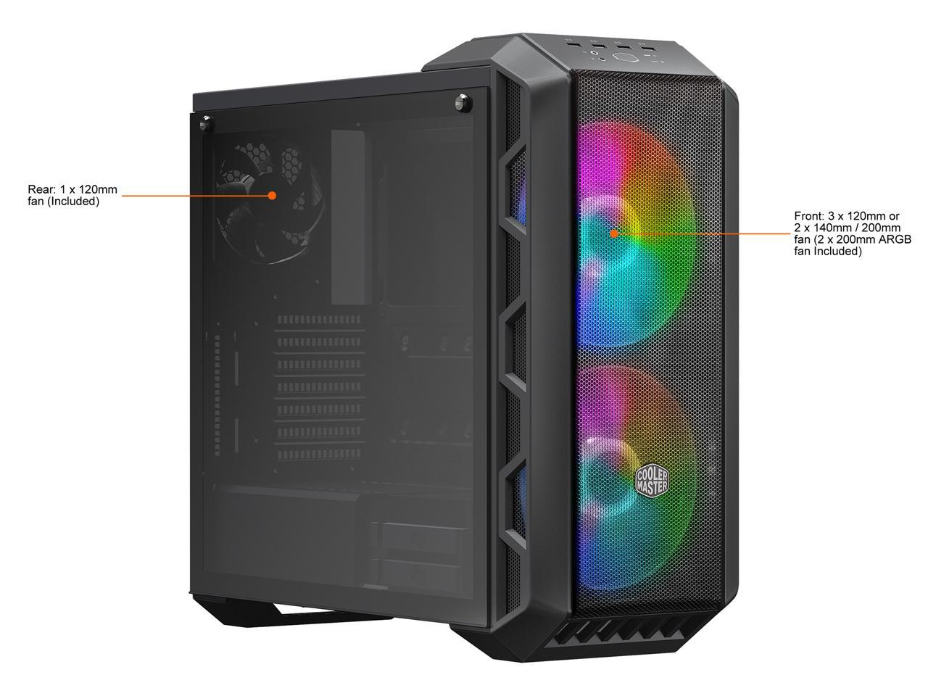
System Cases – What to look For
Size & space (GPU/PSU/Mobo)
Drive bays (2.5”/3.5”/5.25”)
Front I/O Ports (USB/Mic)
Size of case fans
Accessibility
Overall look
LEDEEEEEEES
Notes:
https://www.newegg.com/gunmetal-cooler-master-mastercase-h500-atx-mid-tower/p/N82E16811119350

Slide 7
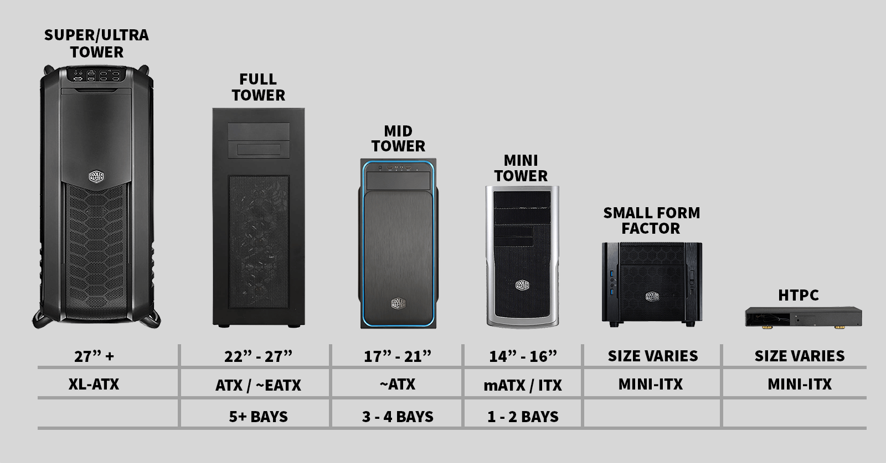
System Case Sizes

Slide 8
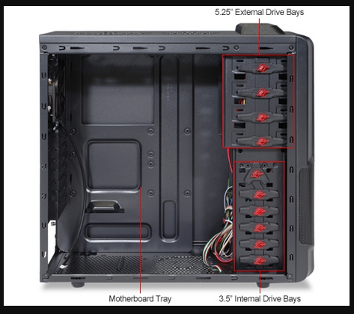
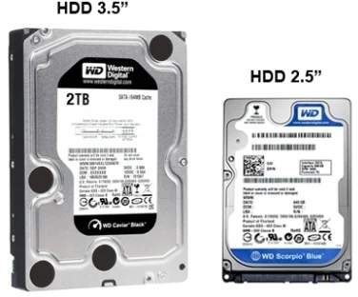
System Case Bays
Notes:
Comes in 3 sizes:
2.5” – Usually SSDs
3.5” – Usually HDDs
5.25” – Usually Optical Drives
Size roughly refers to width of the drive
Newer cases usually have only 2.5” and 3.5” bays

Slide 9
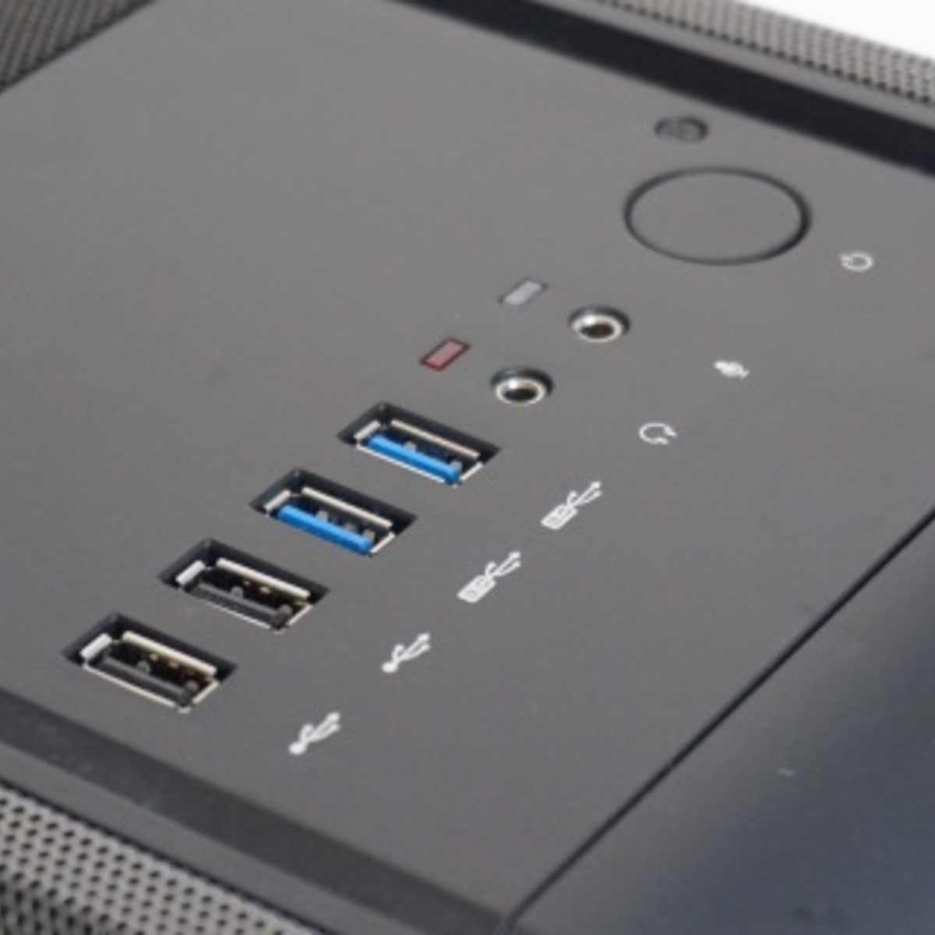
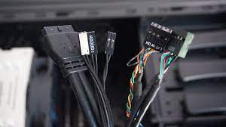
System Case I/O Ports
Notes:
Usually consists of USB and audio ports
Ports connect back to the motherboard via header cables

Slide 10
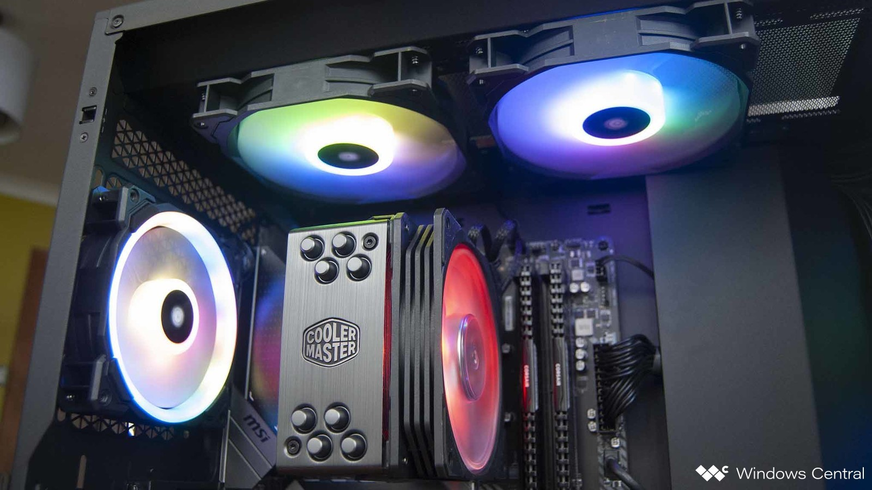
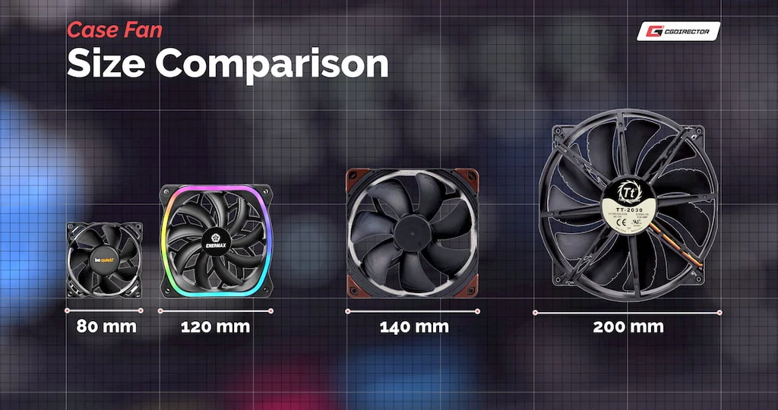
System Case Fans
Notes:
Come in many different sizes
Normal case fans are 80 and 120mm
Measurement is width of the fan

Slide 11
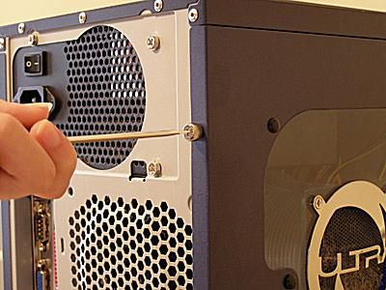
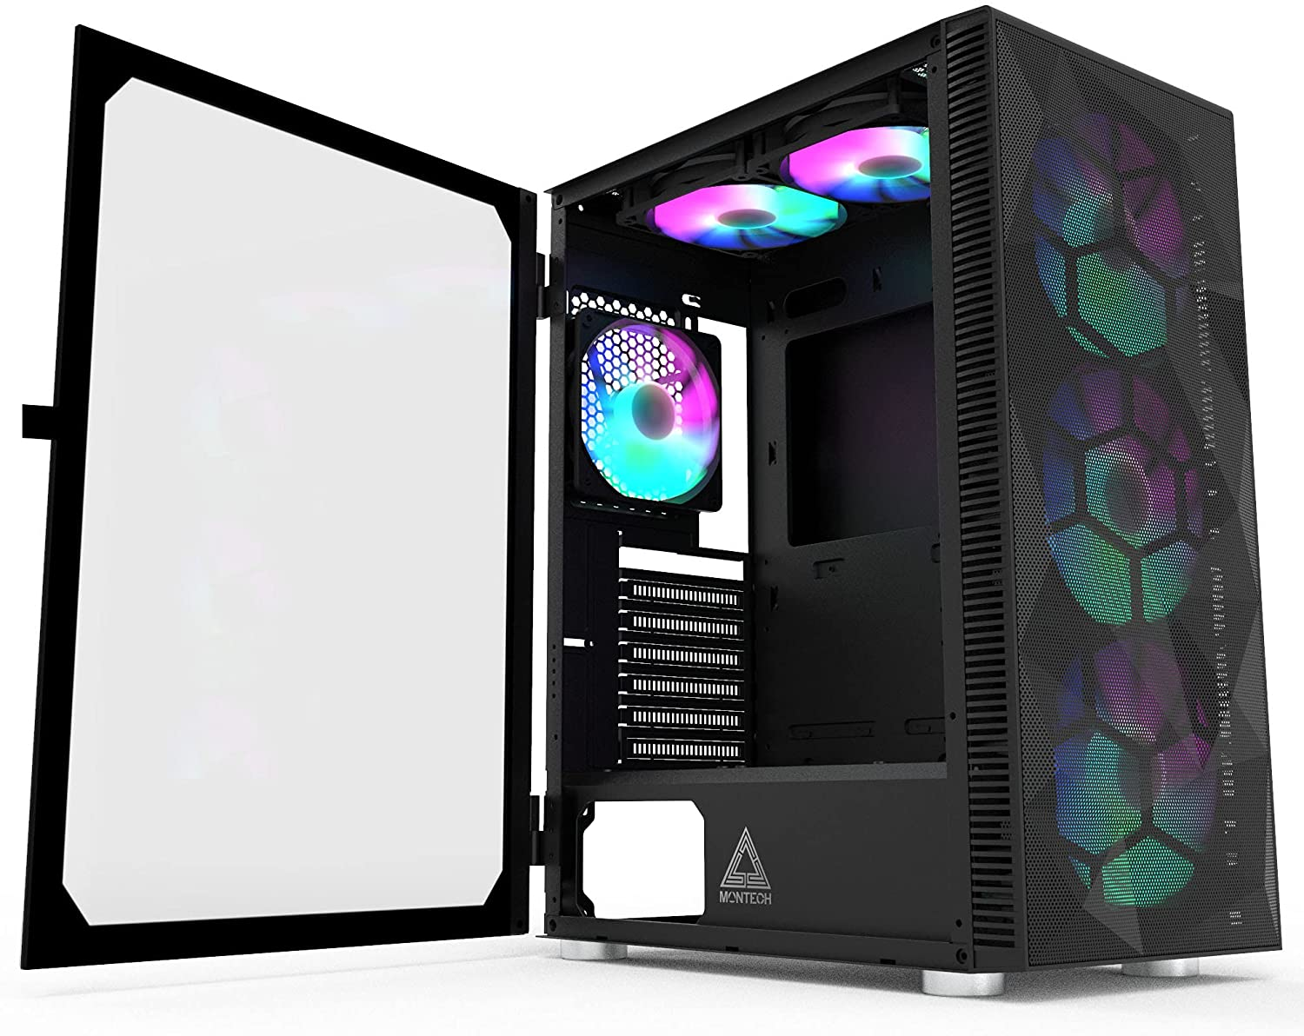
System Case Accessibility
Notes:
Ease of opening side panel
Spaciousness inside for airflow and access

Slide 12
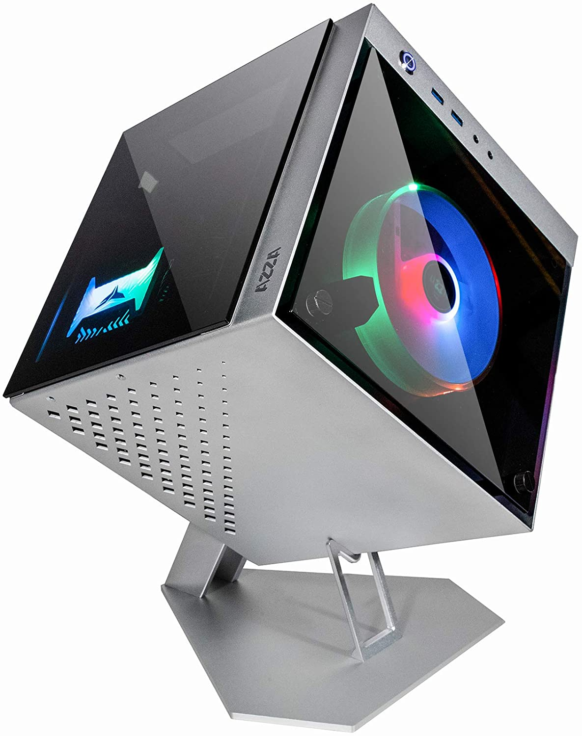
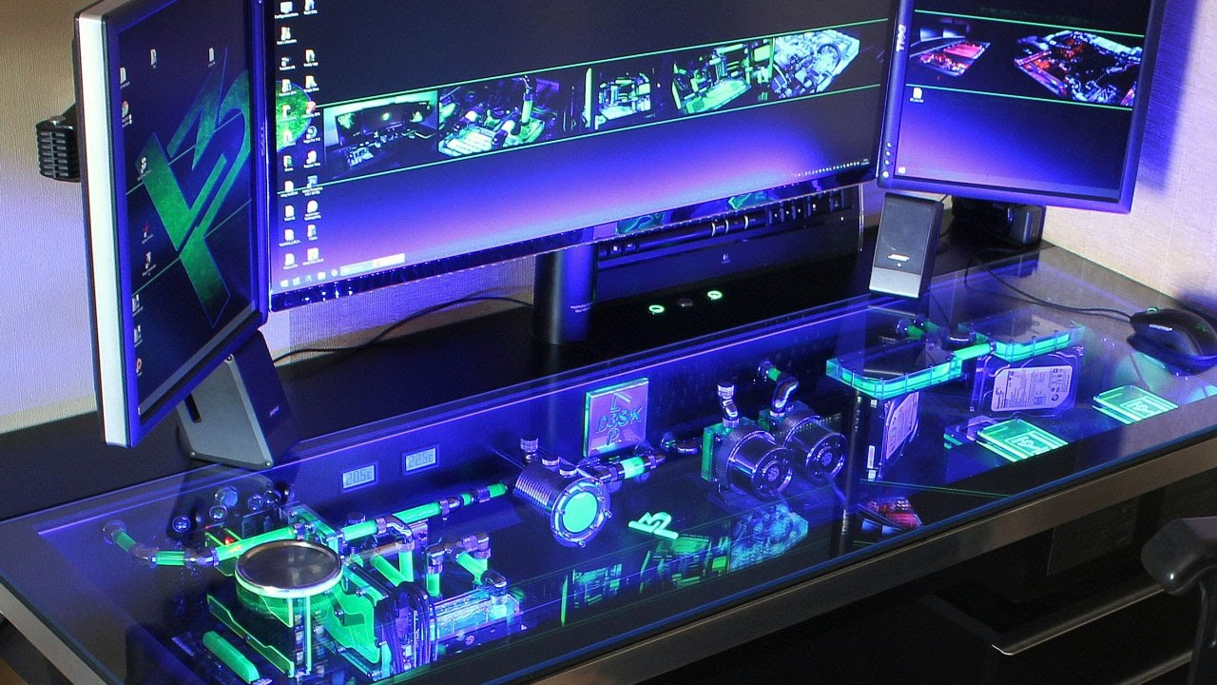
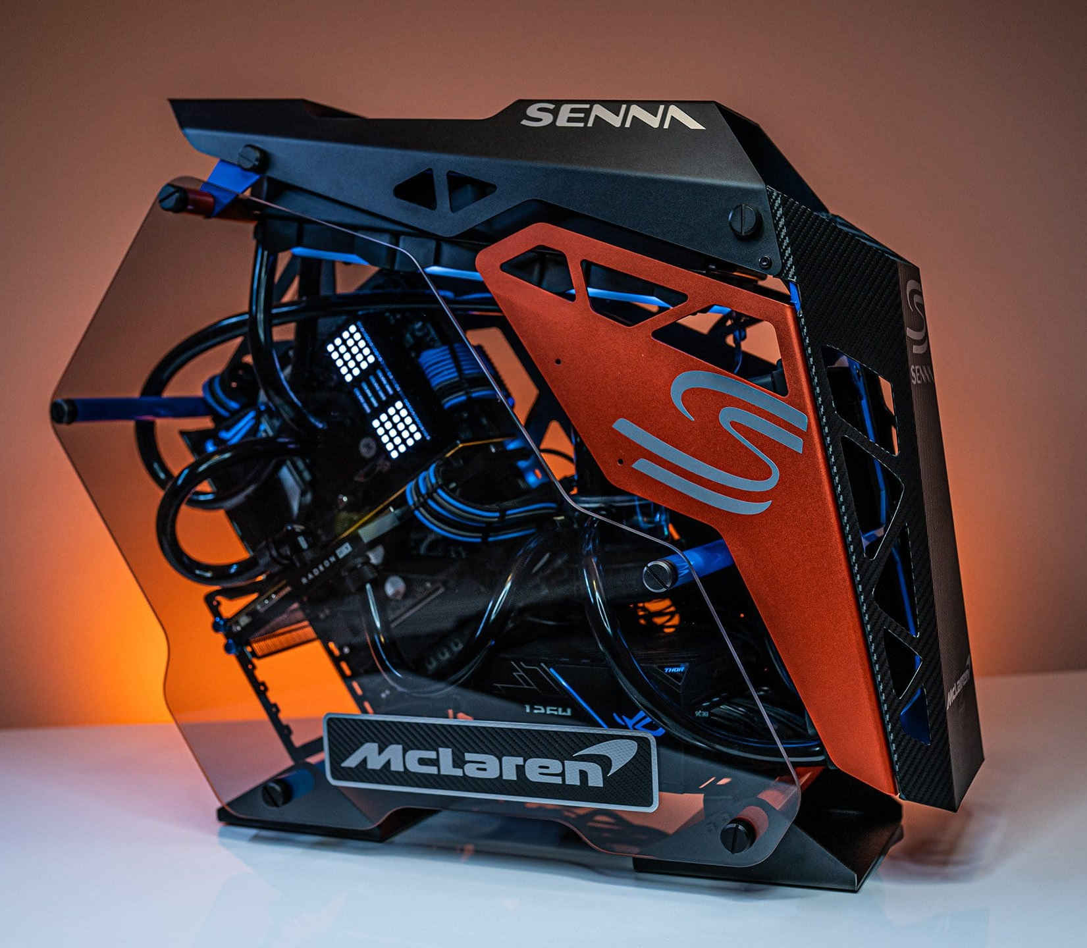
System Case Style
Notes:
Style sometimes requires sacrifice of space and/or accessibility
Usually pricey

Slide 13
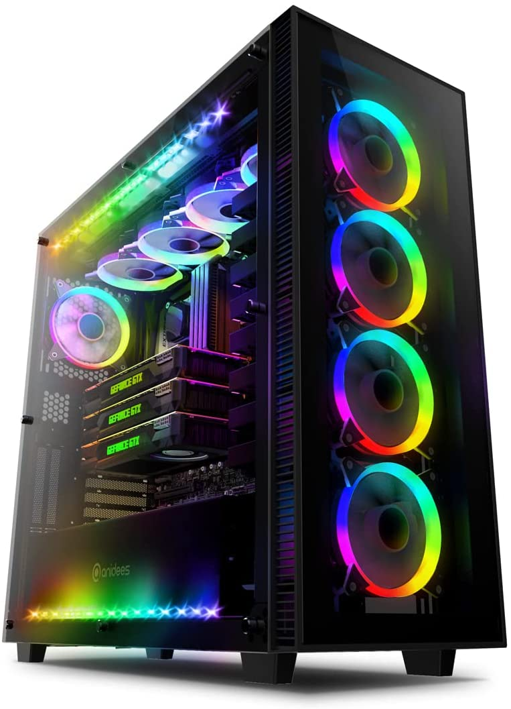
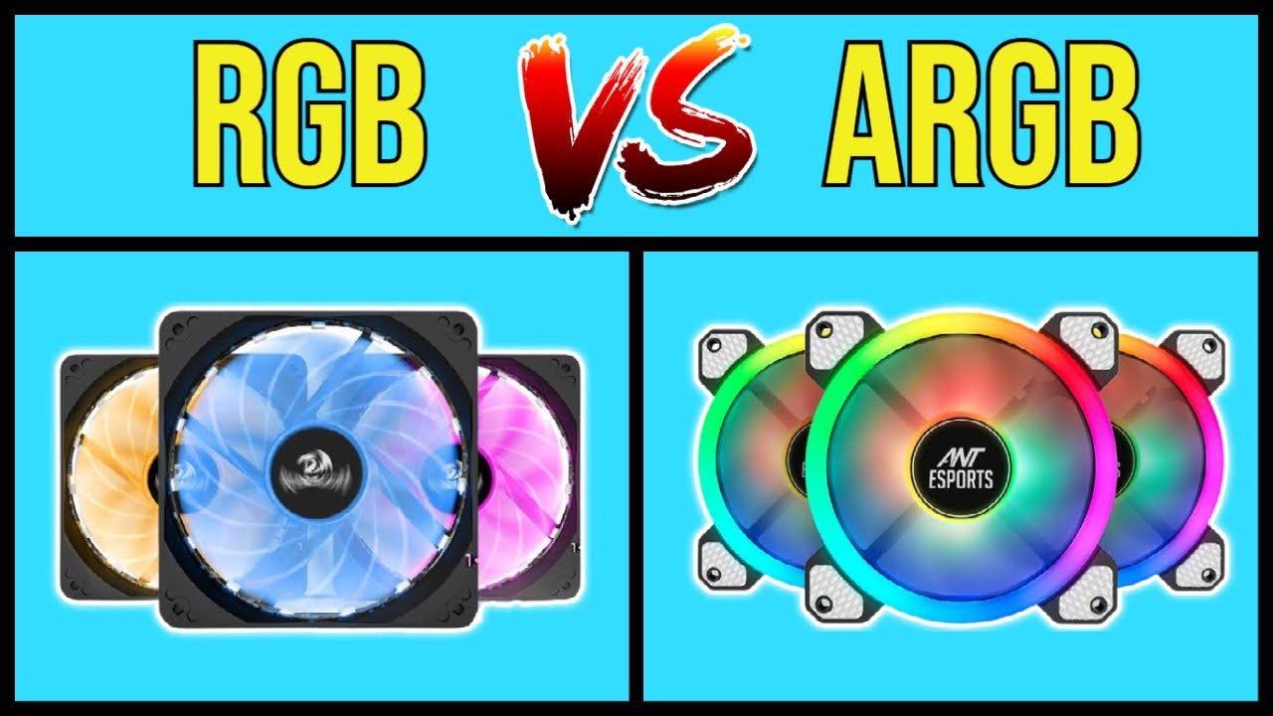
System Case LEDs
Notes:
Two types of LEDs
RGB
Static lighting, shows one color at a time
Can show patterns and change colors, but typically not that dynamic
Think LED light strips
ARGB – Addressable RGB
Capable of dynamic lighting
LED devices contain microchips to control individual LEDs
Uses a controller to sync lights

Slide 14
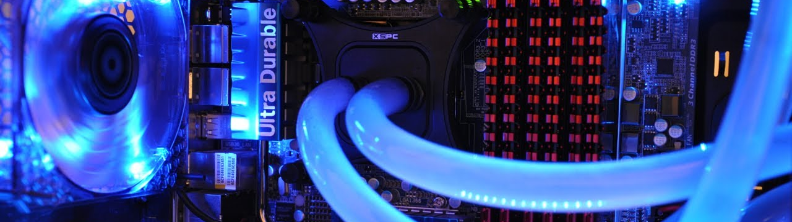
Cooling Solutions

Slide 15
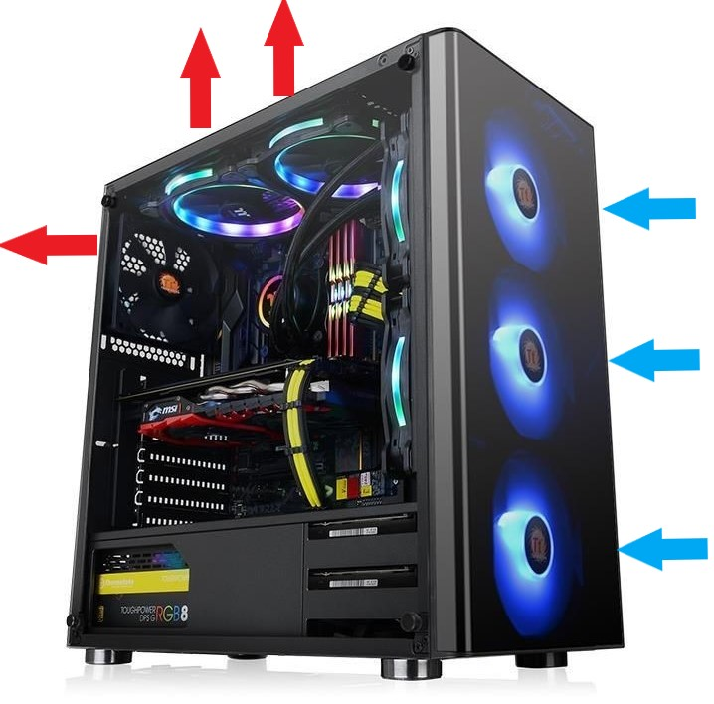
Cooling Solutions – Fans & Airflow
Notes:
Most common cooling solutions are fans and heatsinks
Cool Air intake occurs at front of case
Hot air is exhausted out the back and top of case

Slide 16
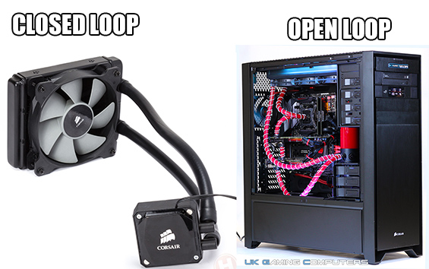
Cooling Solutions – Liquid
Notes:
Uses electronic-friendly liquid coolant and pump system
Coolant flows over components and into a radiator where fans cool the liquid
Offers better cooling than fan and radiator
Often used with high-temperature components (GPUs) or in heavy processing environments (Video processing)

Slide 17
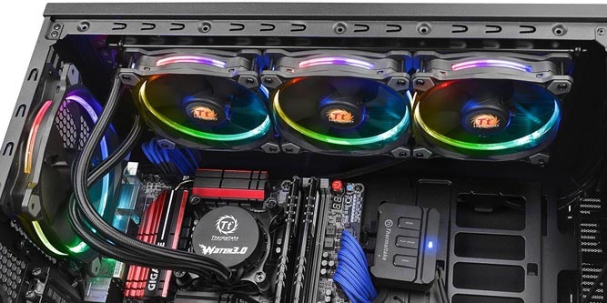
Cooling Solutions – Closed Loop
Notes:
Also called “All-In-One” or “AIO”
Focuses on one PC component
Pre-assembled system
Cheapest liquid cooling option

Slide 18
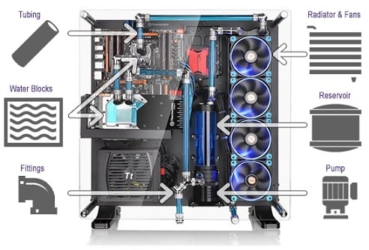
Cooling Solutions – Open Loop
Notes:
Custom cooling build that requires full assembly
Provides more customization options
Can tie into multiple components
Expensive and difficult to setup
More prone to leaks

Slide 19
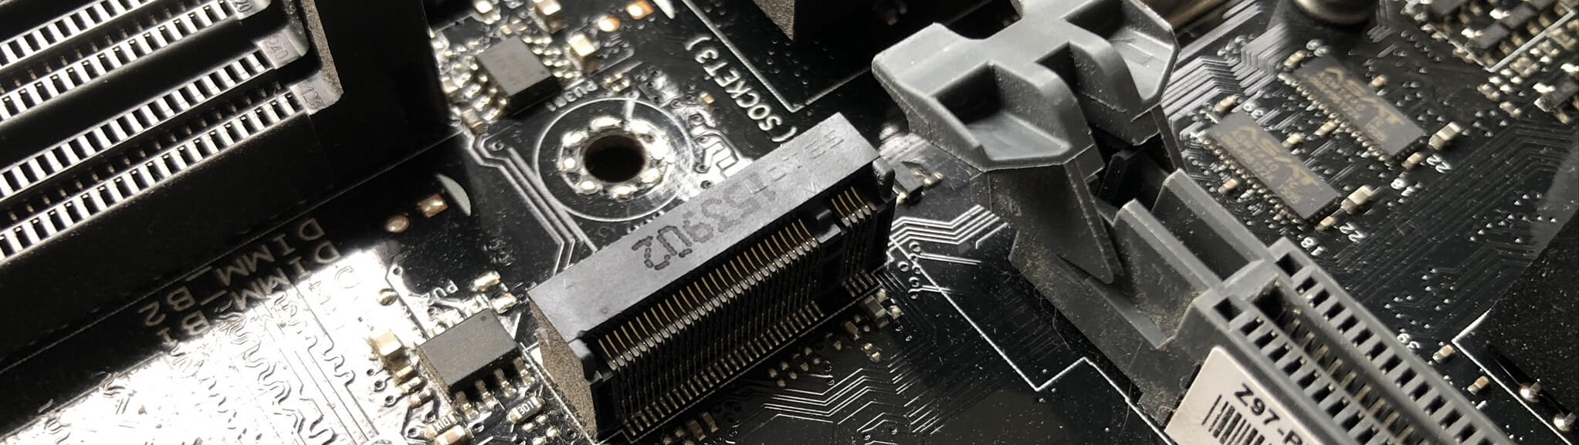
Motherboards

Slide 20
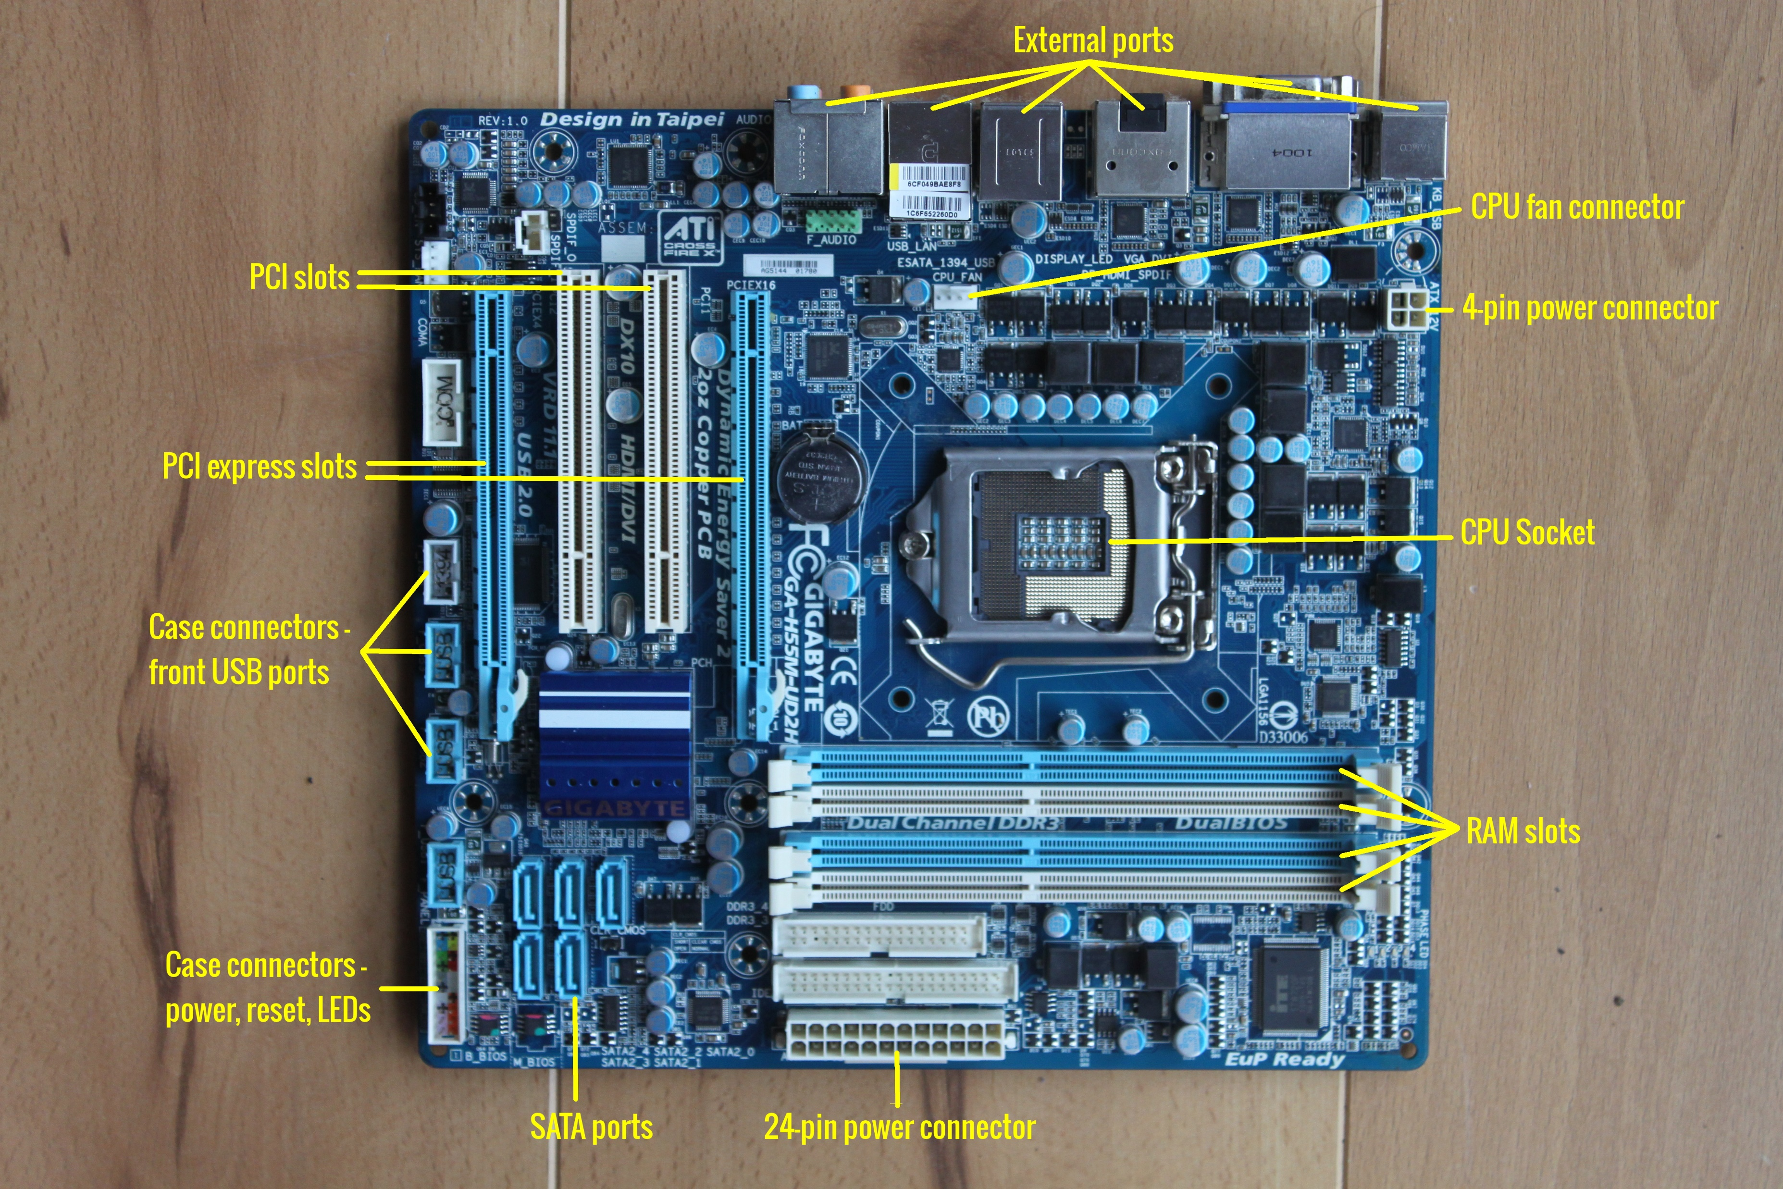
Mother-board (aka Mobo)
Make & Model Number – Gigabyte
GA-H55M-UD2H
Notes:
CPU Socket – Holds a CPU of a specific slot type
SATA (Serial ATA) – Used for hard drives & other storage devices
PCI Slots – Available in the original flavor and express, the high speed version
Case Connectors – Connects to USB Ports, reset buttons, status lights & more that are built into the case
Power Connectors – Main power supply for the motherboard is 24-pins, usually also has a secondary power 4 pin connection for the CPU
External Ports – Ports found on the backside of the case once its closed. Can include a wide variety of external device connectivity

Slide 21
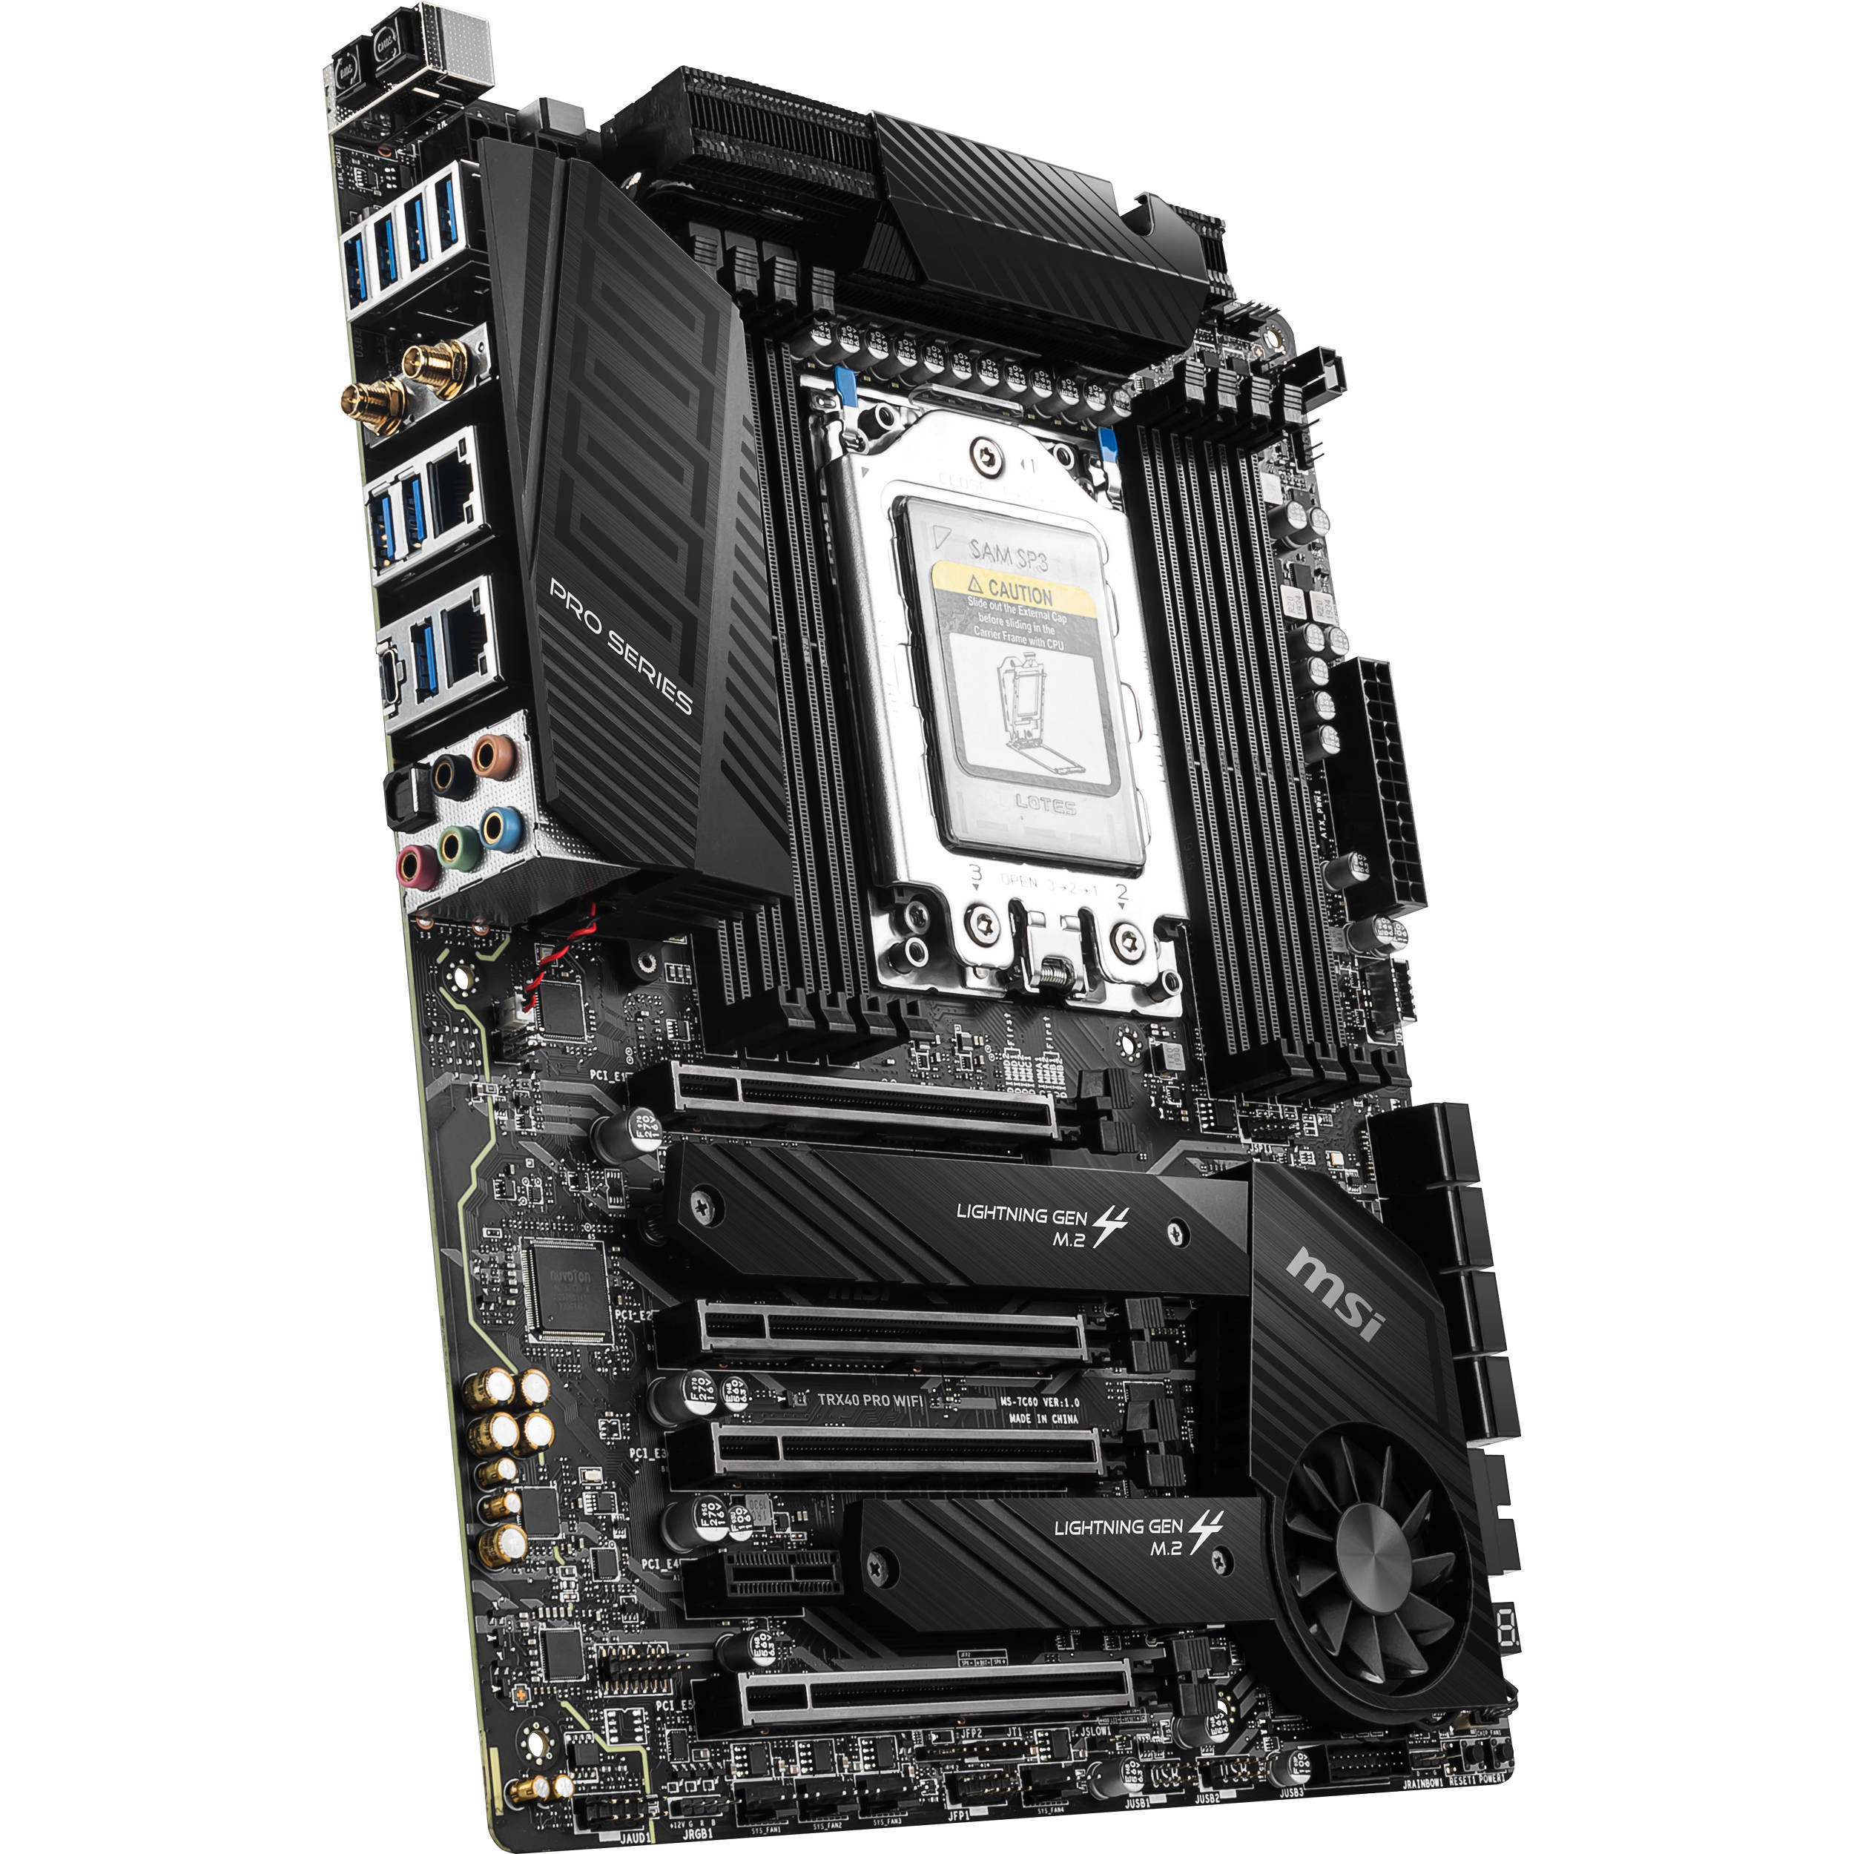
Motherboards – What to look For
Form factor
Chipset
Socket type
Supported RAM
Storage Connections
Expansion Slots
I/O Connections

Slide 22
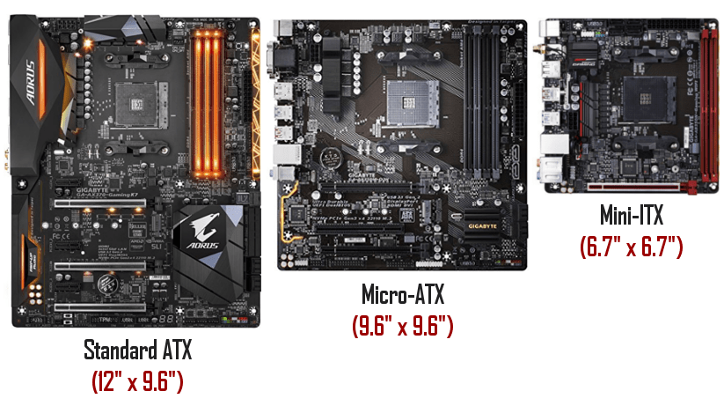
Motherboards – Form Factors
Notes:
Most common desktop form factors are ATX and Micro-ATX
Consider form factor when buying a system case
Larger form factor usually means more connections

Slide 23
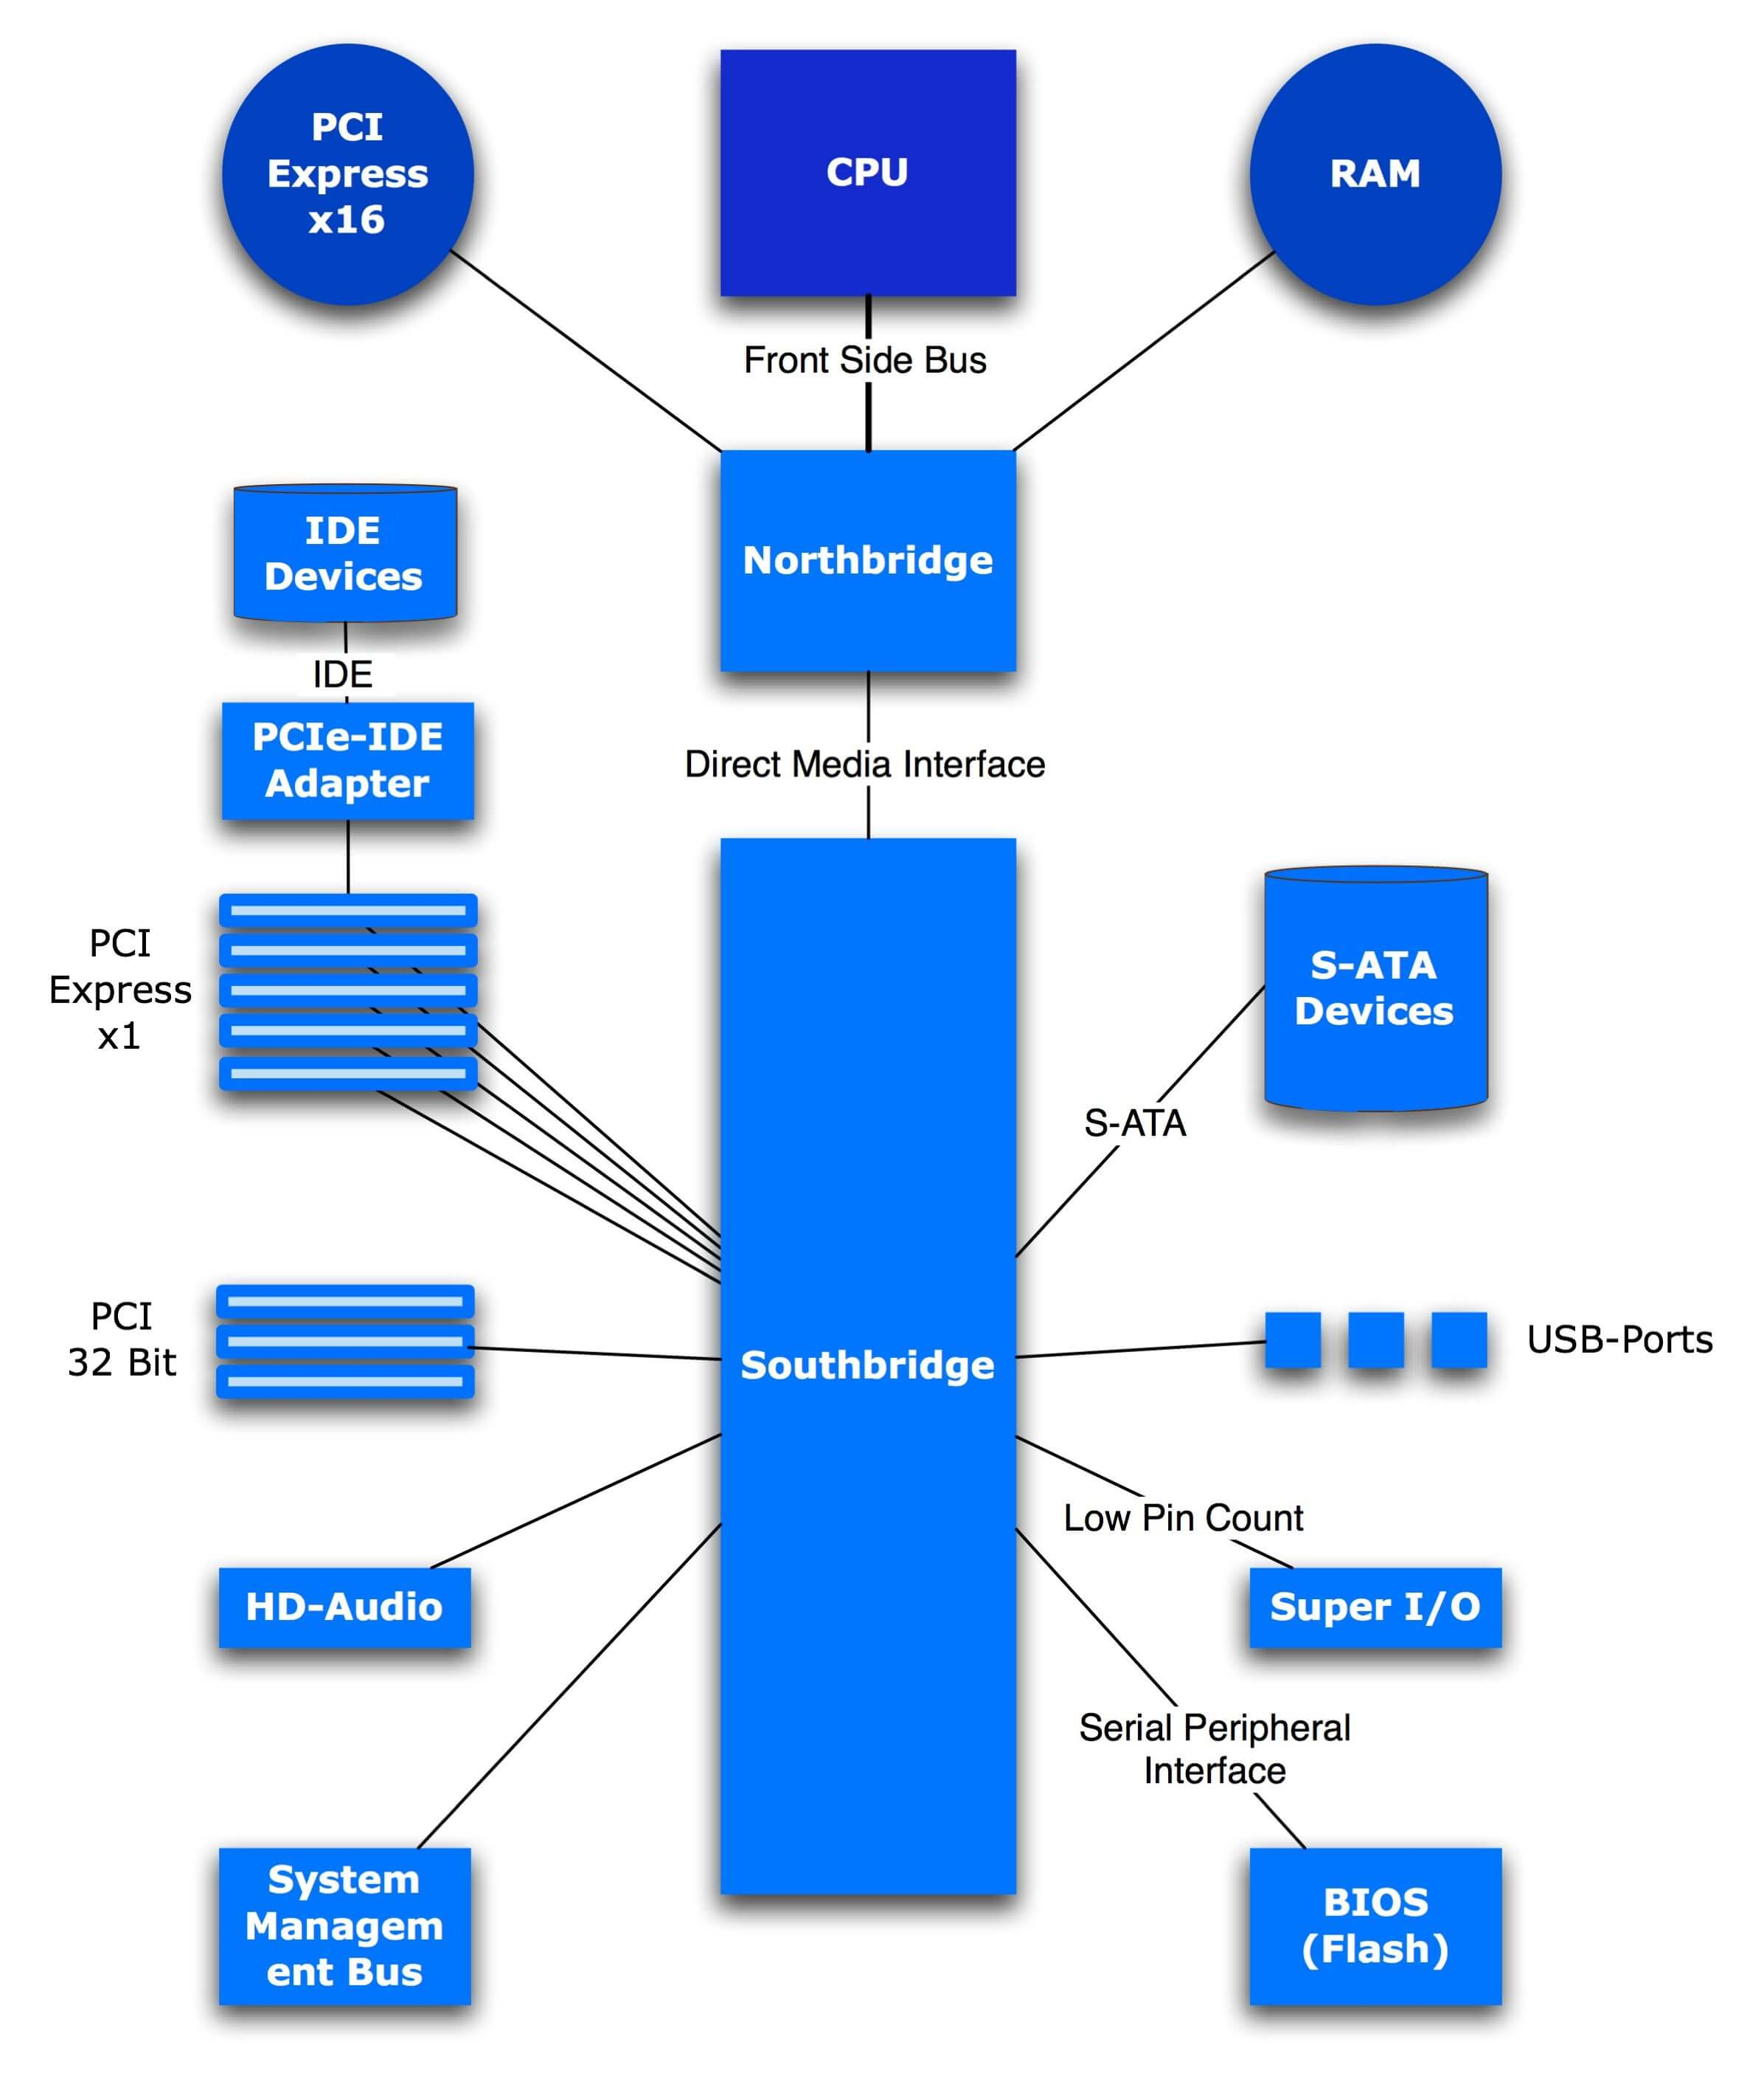
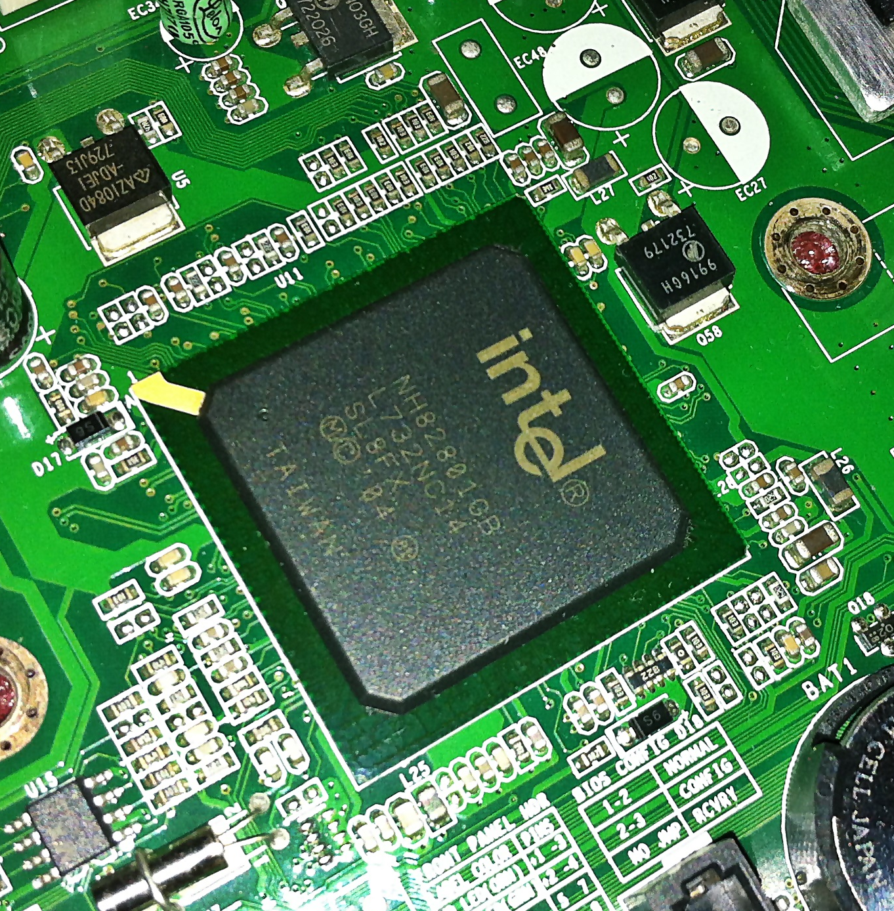
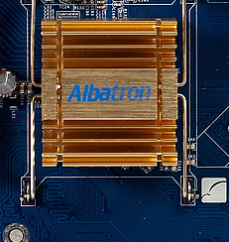
Motherboards - Chipsets
Northbridge
Southbridge
Notes:
Chipsets are used across vendors
Ex: Intel Z270 Chipset
Chipset is responsible for communication between motherboard components
Chipsets determine:
CPU compatibility
Supported RAM
PCIe lanes
…and more
Expect to see southbridge near the ‘bottom’ of the motherboard, near the PCI slots and SATA ports, typically without a heatsink
Expect to see the northbridge near the CPU of the motherboard and it will typically have a heatsink

Slide 24
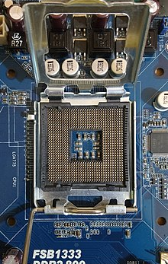
Motherboards – Socket Type
Notes:
Determines what CPUs will plug into the motherboard, but doesn’t guarantee the CPU will work with it
Always check motherboard specs for specific CPU support
Sockets have a protective hatch that presses and holds CPU in place
Latch both holds hatch closed and creates connection between pins and socket

Slide 25
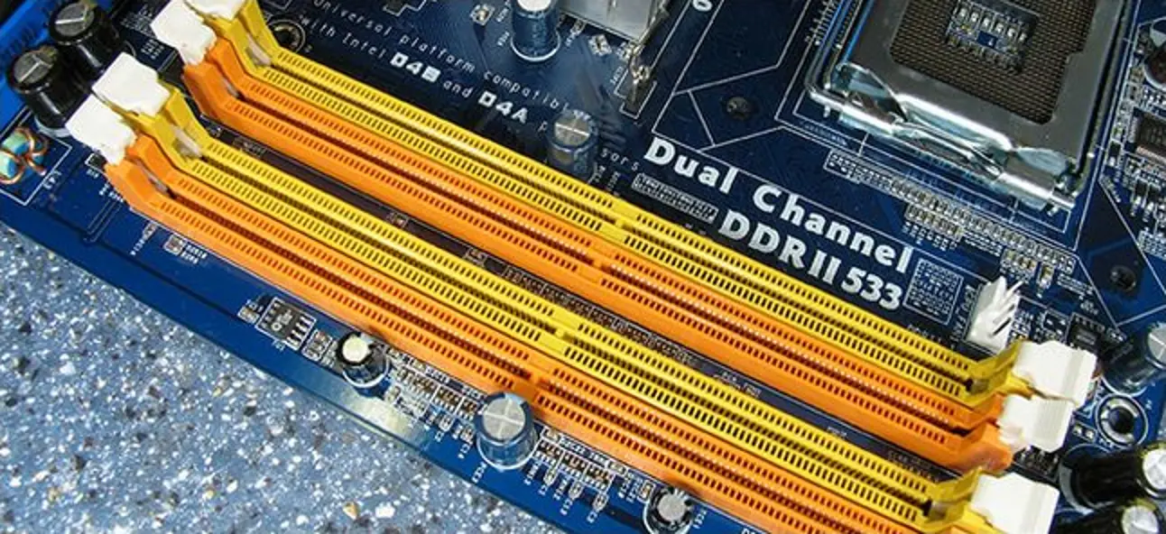
Motherboards – Supported RAM
Notes:
Motherboard specs will specify supported RAM:
Speeds
Form factor
Per chip and total capacity
Always check for Dual Channel configuration
This allows pairs of RAM chips to work more effectively
Requires RAM to be inserted in certain slots
Slots are usually color coded to show this

Slide 26
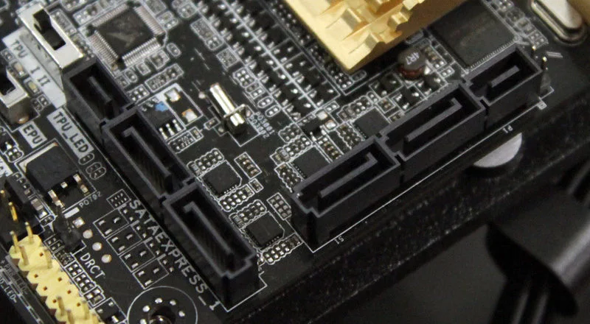
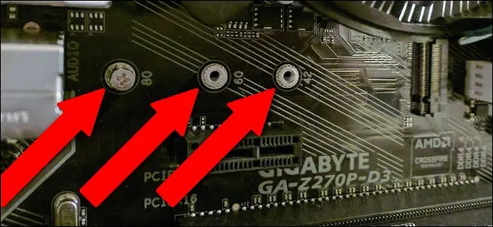
Motherboards – Storage Connections
Notes:
Determines the number of SATA and M.2 storage devices
Works with a storage controller on the motherboard
M.2 slots also support multiple widths and lengths
Ex: 2280 specifies a width of 22mm and length of 80mm
Check specs for supported M.2 sizes

Slide 27
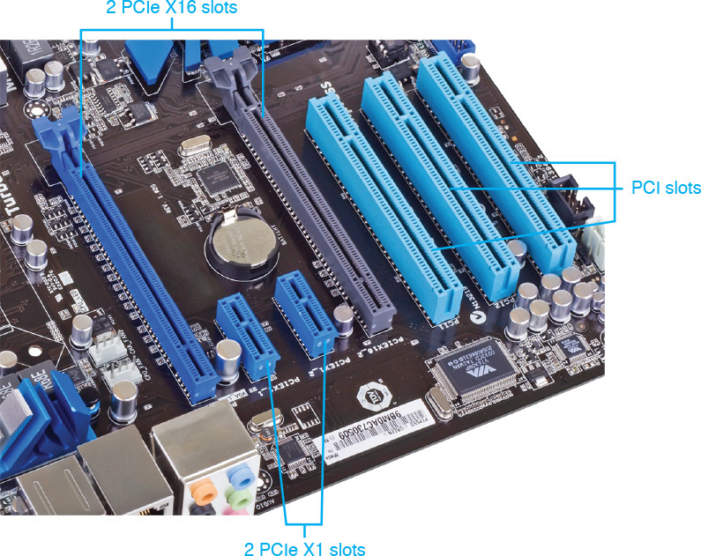
Motherboards – Expansion Slots
Notes:
Describes number and type of PCIe slots
Peripheral Component Interconnect Express
Provides a means of adding additional components to the PC
Ex: Graphics cards, network cards, USB ports, SATA or M.2 ports, and much more
Some motherboards have non-express, legacy PCI slots still, but are becoming rare

Slide 28
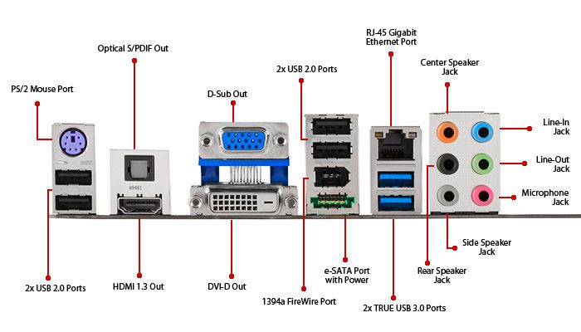
Motherboards – I/O Connections

Slide 29
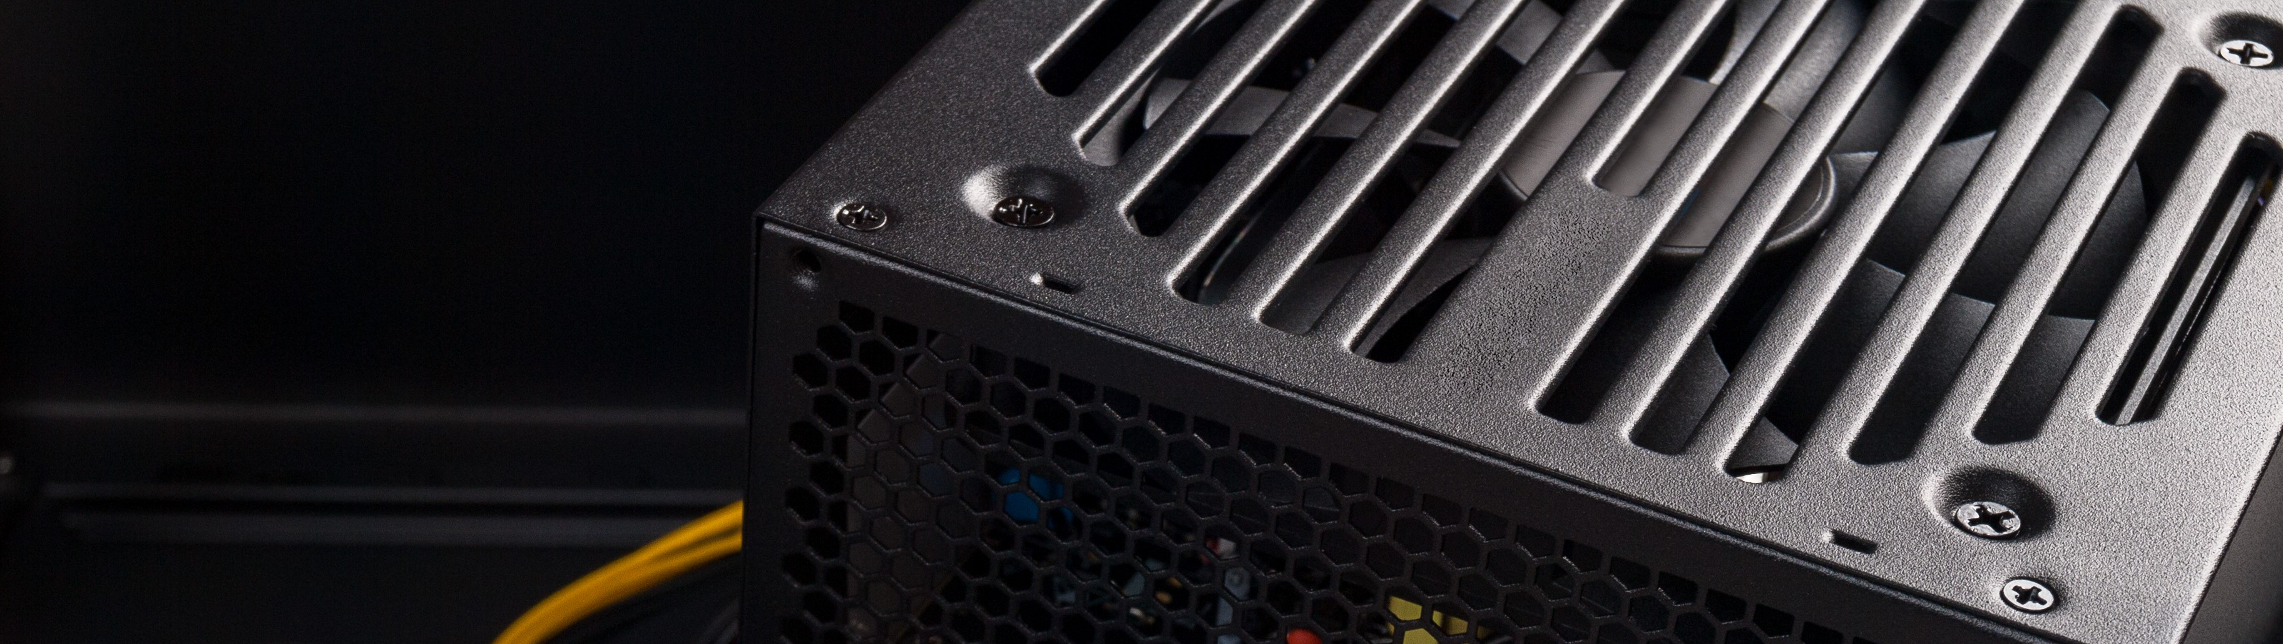
Power Supply Units (PSU)

Slide 30
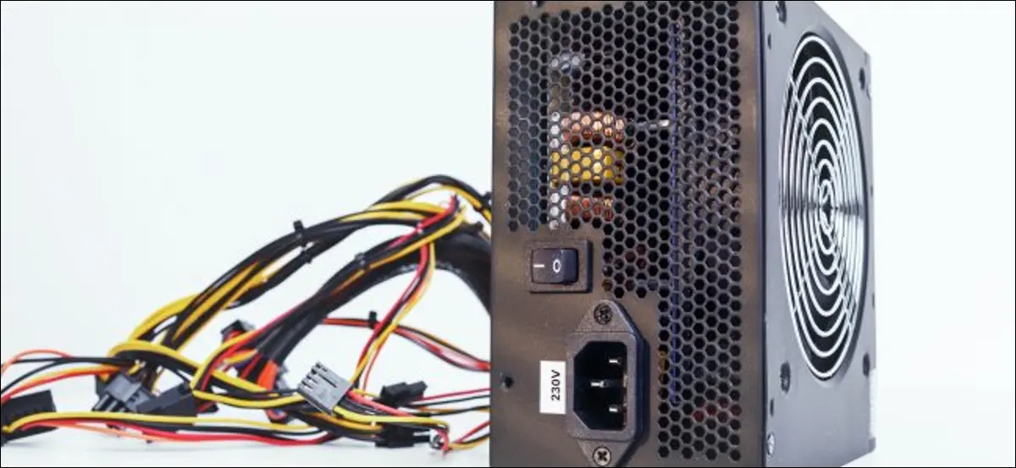
Power Supply Units (PSU)
Notes:
Powers PC Components
Has different form factors and power outputs
PSUs are rated by their efficiency
One of the trickiest parts of the PC to troubleshoot
DON’T GET A CHEAP PSU

Slide 31
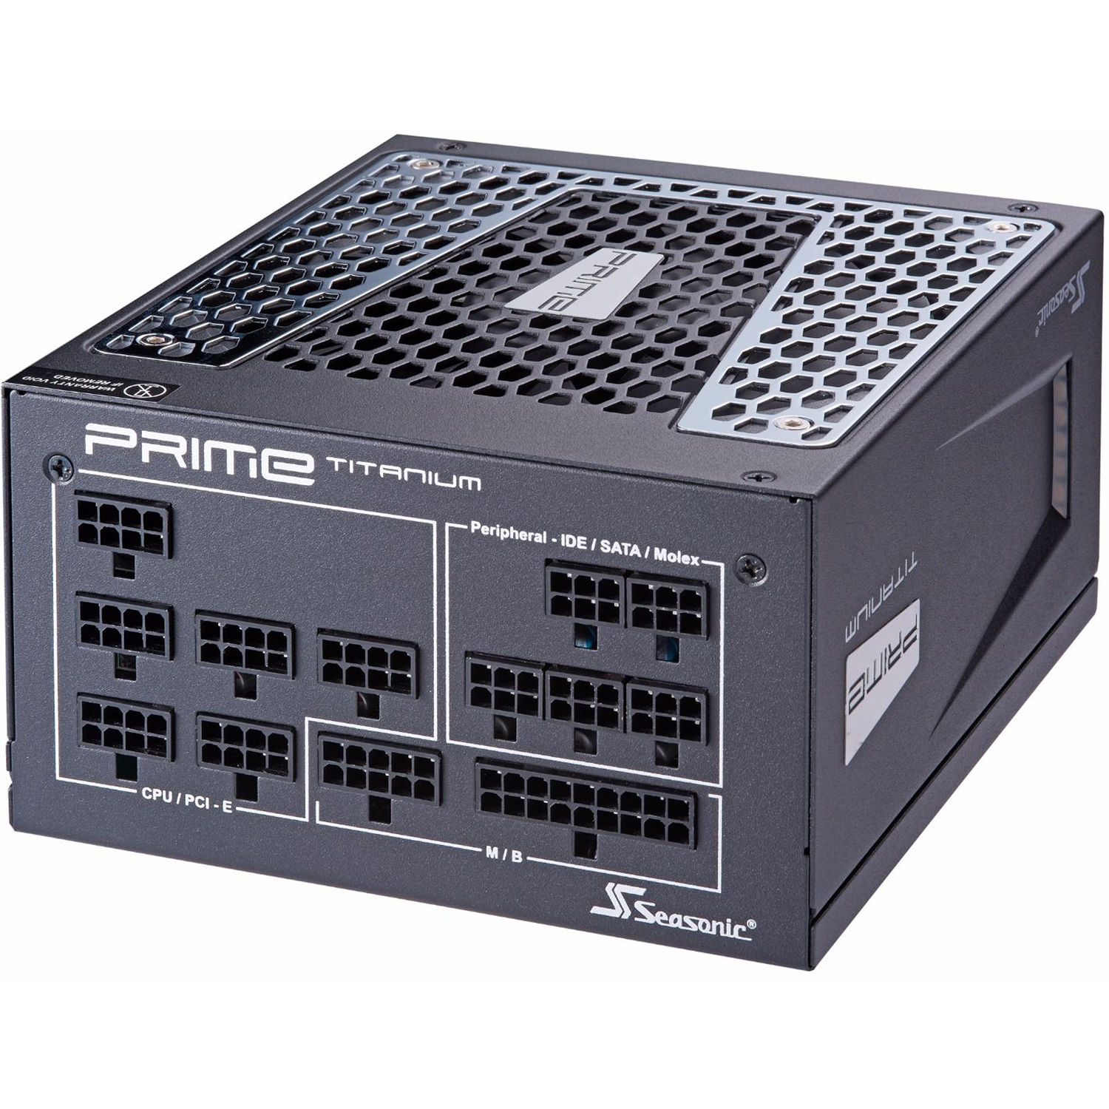
PSU – What to look For
Form factor
Wattage
Power connections
Modularity
Efficiency Rating

Slide 32
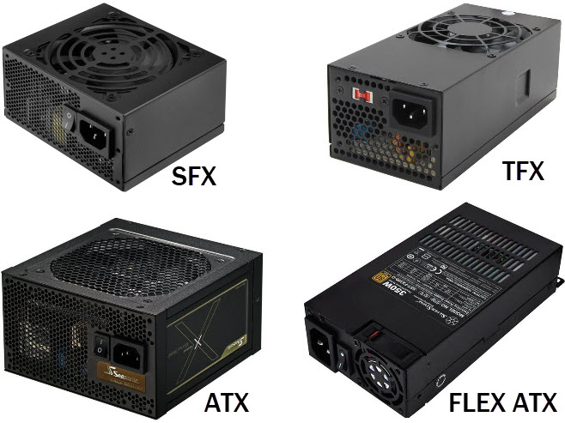
PSU – Form Factor
Notes:
Most common form factors are SFX and ATX
Your system case will specify which form factors it will accept

Slide 33
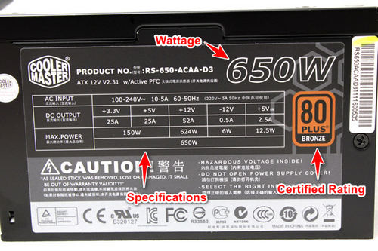
PSU - Wattage
Notes:
Wattage should consider maximum draw of all installed components
Generally, should not exceed 80% of PSU wattage
Use an online power consumption calculator to determine PSU needs (links in slide notes)
PSU Wattage Calculators:
https://www.newegg.com/tools/power-supply-calculator/
https://outervision.com/power-supply-calculator

Slide 34
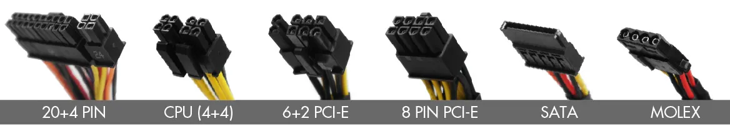
PSU – Power Connections
Notes:
Always check PSU specs to see what power connection cables it includes
Make sure PSU includes enough connections for your PC plus future expansion

Slide 35
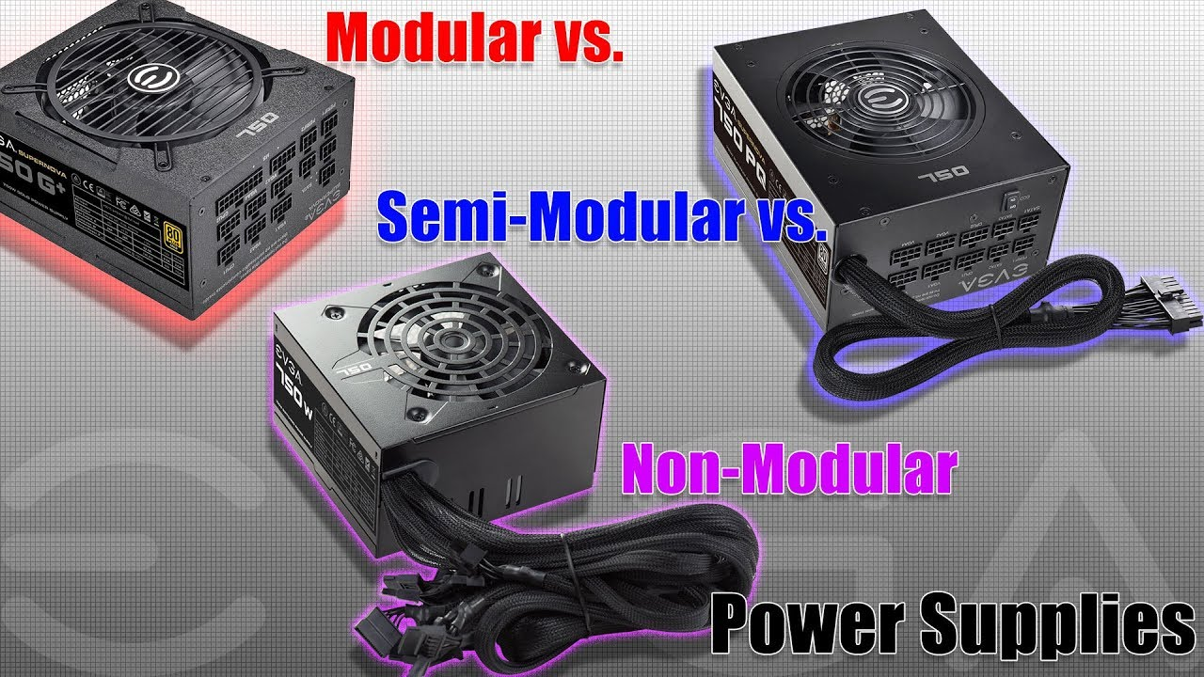
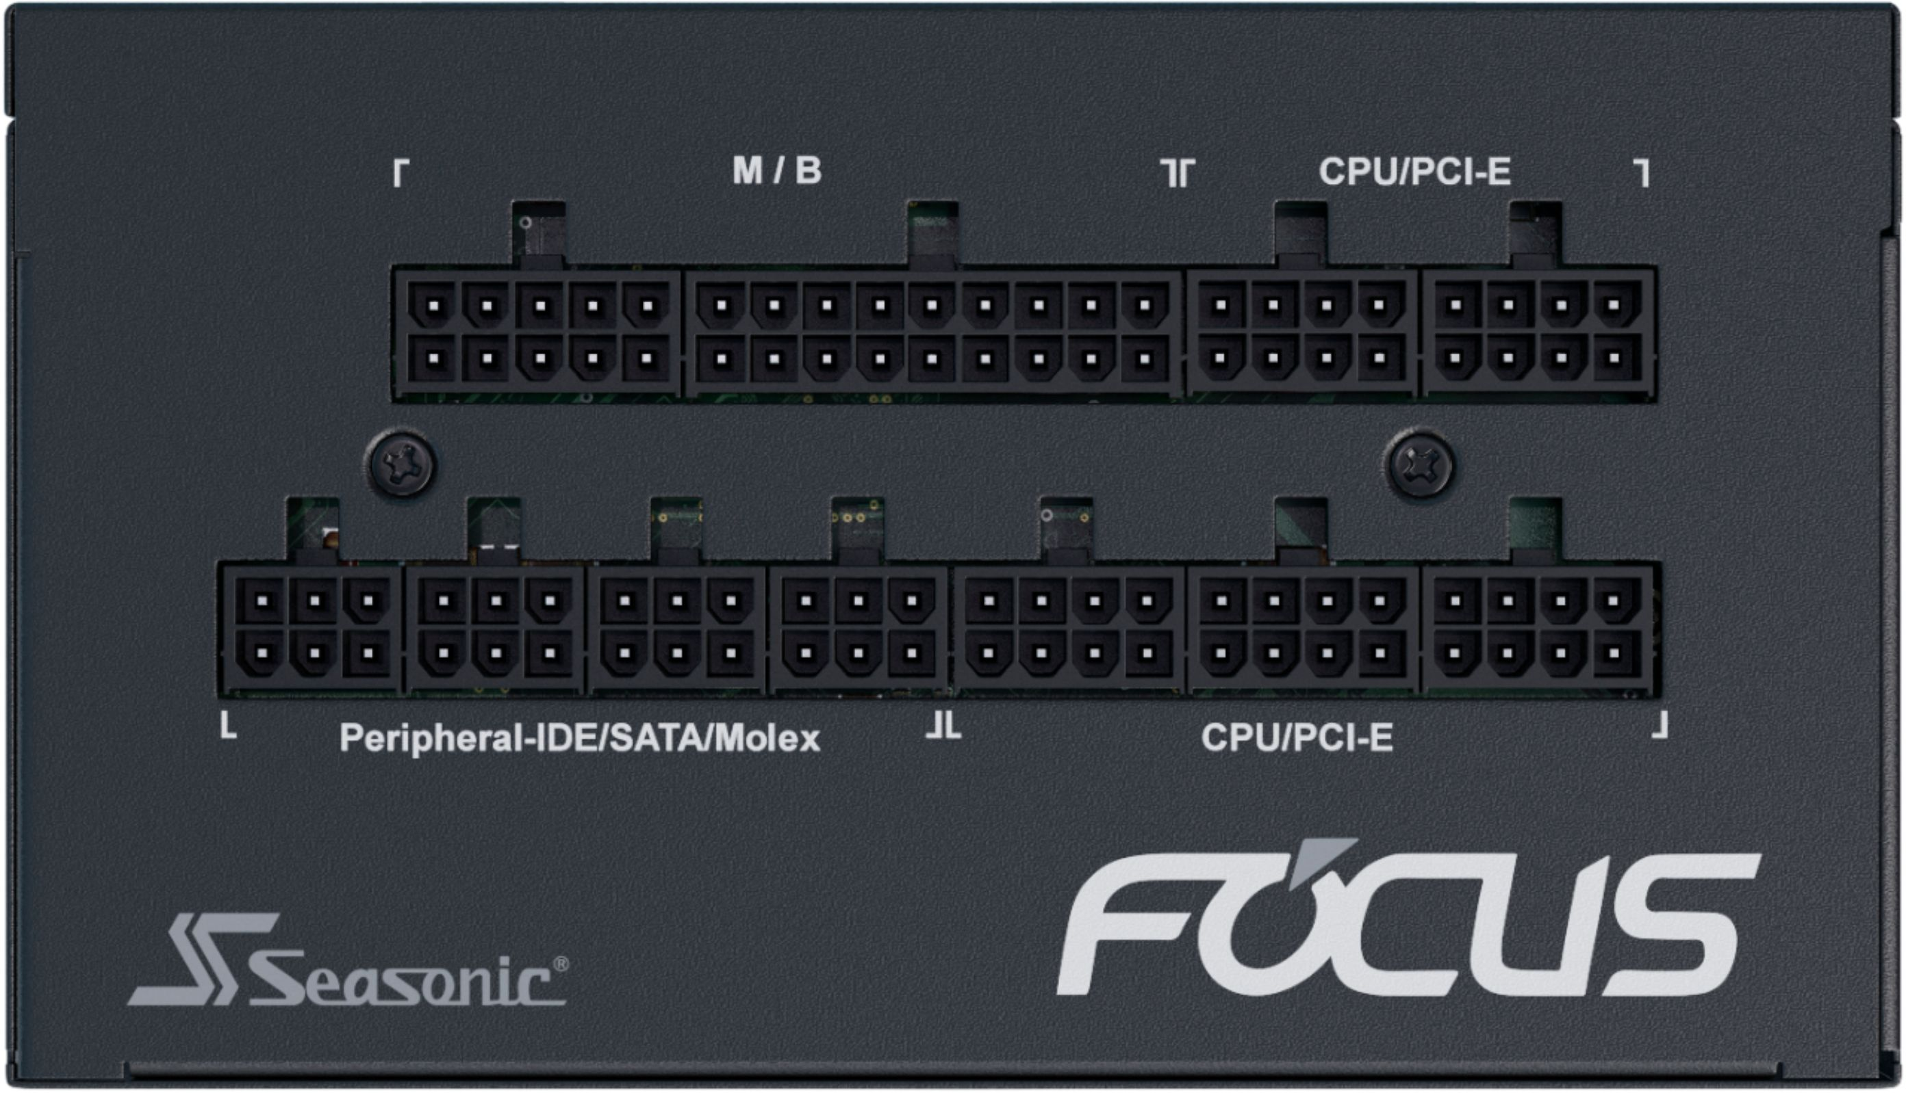
PSU – Modularity
Notes:
Modular
No built-in cables
Allow you to only plug in cables you need
Cleaner design
Semi-modular
Most common cables are built in, others are modular
Cheaper than full modular
Non-modular
All cables are built in
Warning: DO NOT arbitrarily mix cables from one modular PSU with another

Slide 36
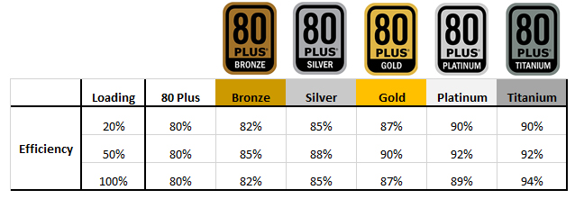
PSU – Efficiency Rating
Notes:
Determines how well a PSU can convert AC power to DC power
Ex: a PSU that was 50% efficient would draw 1000W from the wall to generate 500W for your PC
Efficiency varies based on the PSU load
80 Plus means a PSU is at least 80% efficient at 20%/50%/100% loads
The rating system above was made to market efficiencies in PSUs beyond the standard “80 Plus”

Slide 37


PSU – Buyer Beware
Notes:
Buy quality PSUs
Research and observe max loads
Run at 80% capacity and below

Slide 38

CPUs

Slide 39

Central Processing Unit (CPU)
Notes:
‘Brain’ of the computer
Largely determines performance of a computer
Consists of billions of transistors
Responsible for executing code
Vendors: Intel, AMD, Qualcomm
Architectures: x86, x86-64, ARM
This describes the instruction set that the chip can understand
This is relevant to programmers
https://developer.arm.com/ip-products/processors
https://www.ranker.com/list/the-best-cpu-manufacturers-and-top-cpu-brands/computer-hardware

Slide 40






CPUs Through the Years
(Ryzen CPU bottom with pins)
Intel 80286 (No socket)
Intel 386 (bottom)
Modern AMD & Intel CPUs
(Intel CPU bottom with pads)
Pentium III 600Mhz (weird form factor)

Slide 41

Machine Cycle
Notes:
Machine Cycle
In the CPU, the primary components are the ALU (Arithmetic Logic Unit) that performs mathematical, logical, and decision operations and the CU (Control Unit) that directs all of the processors operations.
The speed (clock speed) and capabilities of the processor have dramatically improved. For example, the first microprocessor was the Intel 4004 that was released November 15, 1971 and had 2,300 transistors and performed 60,000 operations per second. Current processors have at least 3,300,000 transistors and performs around 188,000,000 instructions per second.

Slide 42

CPUs – What to look For
Socket type – must match motherboard
Speed – measured in GHz
Number of Cores – number of logical CPUs inside the physical chip

Slide 43

CPUs - Socket Type
Notes:
Determines size, shape and pinout
Socket type is generally associated with a specific vendor
Ex: Intel’s “LGA 1200” or AMD’s “Socket AM4”
Must match socket type of motherboard
Matching sockets does not guarantee motherboard support

Slide 44

CPUs - Speed
Notes:
Measures how many `cycles` per second the CPU executes
Modern CPUs operate in GHz or billions of cycles per second
Ex: A single cycle at 1.8 GHz takes 555 picoseconds to compute (0.000000000555 Seconds)
The more cycles per second, the faster the CPU

Slide 45

CPUs – Number of Cores
Notes:
Cores are logical CPUs inside the main CPU chip
Each core is a separate CPU capable of doing its own processing
Cores run parallel to each other
Applications can use multiple cores to split up the work
Other technology like Intel’s hyperthreading virtually creates more cores

Slide 46

RAM

Slide 47

RAM aka Memory
Notes:
Random Access Memory = RAM
High speed, temporary storage
Connects to Northbridge of Motherboard
Used by applications, operating system, etc to load
Volatile memory
Erased when power is lost
Looks like a rectangular, slim circuit board
May or may not include a heatsink/heat spreader

Slide 48

RAM – What to look For
Form factor
Speed
Capacity

Slide 49


RAM – Form Factor
Notes:
Desktops use DIMM (Dual Inline Memory Module) form factor
Laptops use SO-DIMM (Small Outline Dual Inline Memory Module) which are shorter
RAM is further divided into more form factors specified by DDR*
Notches on the connector of the RAM prevent it from inserted into the wrong slot type

Slide 50

RAM – Speed
Notes:
Speed of RAM typically refers to its frequency
Frequency is a measure of cycles per second it can perform (like CPU cycles, only for reading/writing data)
RAM chips are labeled according to their frequency and form factor in two equivalent ways:
Speed measured in bits (ex. PC4-19200)
Measured in bytes (ex. DDR4-2400)
Another measure of speed is CAS latency (also called delay or timing)
Both are usually listed on the RAM label
The “PC” speed is basically bits per second. This is the older speed specification
(64-bit bus) * (1 byte / 8 bits) * (megatransfers / second) = (megabytes / second)
The “DDR” speed is bytes per second, this is the newer specification
You should look at the DDR rating for the actual bytes per second speed of your RAM

Slide 51

RAM – Capacity
Notes:
Total amount of data a RAM chip can hold
Capacity of RAM is generally found on the RAM Label
If not, you can look up the model number on the label to find out
FYI: when purchasing RAM, often descriptions will show “16GB (2x8GB)” which means you will get two 8GB chips for a total of 16GB

Slide 52

Storage Devices

Slide 53

What isn’t storage?

Slide 54







What is storage?

Slide 55

Main Types of Storage
Magnetic
Optical
Solid State

Slide 56

Optical Storage

Slide 57


Optical Disc Drives - Components

Slide 58


Optical Disc Drives - Media
Pressed discs with physically recorded data
Discs can have multiple layers to increase the amount of data stored (except CD’s)
Notes:
ref: https://www.scienceabc.com/innovation/how-does-a-compact-disk-cd-work.html

Slide 59


Optical Disc Drives – Media Comparison

Slide 60

Optical Disc Drives - Capacities

Slide 61

Magnetic Storage

Slide 62





Magnetic Storage Devices
Floppy Disks
Tapes
Hard Disk Drives

Slide 63


Floppy Disks

Slide 64

Hard Disk Drives (HDD)
Not to be confused with SSDs
Specifically describes storage with magnetic platters
What to look for:
Form Factor
Capacity
RPMs
Seek Time

Slide 65

Hard Disk Drives - Components
Notes:
Contains several magnetic platters that hold data
Actuator arm hovers over platters to read data magnetically
Spindle spins platters at high speeds
Moveable parts make this very susceptible to shock

Slide 66

Hard Disk Drives - Platters
Notes:
Platter is a circular, metal disk
Core made up of aluminum or glass substrate
Different spin rates depending on the drive
May have 1 or more platters stacked inside drive
Must be kept in a sealed chamber to prevent contamination

Slide 67


Hard Disk Drives – Read/Write Heads
Arms
Read/Write Heads
Notes:
Read/Write heads fit between platters, hovering above them
One head per side of platter (or between platters)

Slide 68

Hard Disk Drives – Scale of Read/Write Heads
VACUUM SEALED:
Notes:
VACUUM SEALED:
It is necessary to keep the internal environment of the hard disk free of dust and other contaminants. These contaminants may get accumulated in the gap between the read/write heads and the platters, which usually leads to head crashes. As we can appreciate from the depiction, the distance between the platter surface (in yellow) and the read/write head is very small. As a matter of fact, it is so small that a finger print smudge is taller that this space. Dust particles are even taller than the mentioned distance. A human hair is a giant when considering this gap between the head and the surface. Perhaps this will help us further understand why it is extremely important no to open your hard drive.

Slide 69


Hard Disk Drives - Form Factors
Notes:
Describes width of the drive
Old hard drives were ridiculously large
Most common form factors:
For desktop computers - 3.5”
For laptops – 2.5” or smaller

Slide 70

Hard Disk Drives – RPMs and Seek Time
Notes:
Revolutions Per Minute (RPMs) measure the speed the platter spin
Typical speeds are 5400, 7200, or 10,000 RPM
Seek time is the time required to move from one ‘track’ on a platter to another
Basically, how fast the read/write heads can move around
These two factors determine the overall speed of the device

Slide 71

Storage Device Interfaces

Slide 72



Storage Interfaces – IDE/PATA
IDE
Integrated Device Electronics
PATA
Parallel Advanced Technology Attachment
40 PIN or 80 Pin
Molex
Max throughput:
133MB/s (PATA 133)
Notes:
So far we have explored the internals of a typical hard disk drive and now let us explore ways that our data can be accessed. The IDE (or Integrated Drive Electronics) is a standard electronic interface used between a computer and its storage devices. The American National Standards Institute adopted it in November 1990. You may also know this as ATA or Advanced technology attachment. The ATA has two interface types, which are the Parallel ATA (PATA for short) and Serial ATA (SATA). The ribbon cable is either a 40 or 80 pin cable and uses a molex connector for powering it up.

Slide 73




Storage Interfaces - SATA
M.2 SATA:
Not compatible
with SATA Data Cable
SATA
Serial Advanced Technology Attachment
Max throughput:
600MB/s (SATA III)
Data Cable
Power Cable
Notes:
The Serial Advanced Technology Attachment ( or SATA) as its name implies, uses serial signaling whereas the previous (ATA or PATA) uses parallel signaling. The advantage that this technology has is that the cables are thinner, more flexible and less bulky for the previous technology mentioned. SATA uses a 7 pin data cable and a 15 pin power cable. This cable may either come as a single unit or split cable. SATA cables provide a higher signaling rate than PATA resulting in faster throughput of data.
SATA

Slide 74

Storage Interfaces – PCIe/NMVe
Max throughput PCIe:
7.8GB/s PCIe 4.0 x4
Notes:
Improves on SATA interface, but not compatible with it
Uses M.2 form factor and NVMe storage controller
Not compatible with SATA M.2
PCIe (Peripheral Component Interconnect Express) began to be used as more than an expansion slot. As SSD device speeds increased, it we necessary to find a faster mode of transportation than SATA, which was designed for slower, spinning disk HDD
NVMe (Non-Volatile Memory Express) is a storage controller protocol designed to handle the high speed data transfers of solid state storage

Slide 75

Expansion Cards

Slide 76


Expansion Cards
Notes:
Plug into the PCI slots
Can include graphics cards, network cards, extra USB ports and much more
PCI Express slots are high speed connections that have direct access to the North Bridge
Legacy PCI slots connect to the South Bridge

Slide 77


Expansion Cards – GPUs
Notes:
GPU – Graphics Processing Unit
Typically installed for gaming, video processing, crypto mining, or other high-end processes
Often can be very power-hungry, so large PSUs should be used with them
Also generate a lot of heat, so sufficient cooling should be used

Slide 78

Peripherals

Slide 79





Peripherals
Notes:
Describes the computer hardware that interface externally with the computer
Examples:
Monitor
Keyboard
Mouse
Printer
Headset

Slide 80

Peripherals: Monitors
Things to check:
Resolution
Panel type
Refresh Rate
Response Time
Size
Connectivity

Slide 81

Peripherals: Monitors – Resolution
Notes:
Decide what resolution you want for your monitor
Remember your GPU needs to be able to support the resolution as well
For larger monitors, choose higher resolutions to avoid pixelation

Slide 82

Peripherals: Monitors – Panel Type
LCD
Most are LED backlit with LCD panel display
3 Types
Twisted Nematic (TN)
Vertical Alignment (VA)
In-Plane Switching (IPS)
OLED
Notes:
LCD
Most are LED backlit with LCD panel display
3 Types
Twisted Nematic (TN) - Cheapest type, lowest image performance
Vertical Alignment (VA) – Better contrast ratio (truer black colors), less light bleed, better color reproduction, slower response times
In-Plane Switching (IPS) – Best LCD color accuracy, response times can be slow
OLED
Panel features individually lit and controlled LEDs
Best contrast ratio since each pixel can be turned completely off
Refresh rates are low
Very expensive

Slide 83

Peripherals: Monitors – Refresh Rate
Notes:
Number of refreshes per second the monitor displays
The higher the refresh rate, the smoother the motion
Not a big deal for office applications, but a huge deal for gaming

Slide 84


Slide 85

Peripherals: Monitors – Response Time
Notes:
How quickly the display can change an LCD pixel from active (white) to inactive (black)
Office applications do not require a low response time
Typical response time is under 10ms
Gaming requires a very low response time
High response times in games causes blurring or ghosting
Gamers look for response times of under 1ms
Best monitors for low response times are VA panels

Slide 86

Peripherals: Monitors – Size
Notes:
Diagonal measurement of the monitor size
Be careful buying large 1080p monitors
Anything larger and the image appears pixelated
Ideal size for 1080p is around 23-25”
2K/4K monitors look better at larger sizes due to pixel density

Slide 87

Peripherals: Monitors – Connectivity
Notes:
Most monitors have multiple connection choices
Be sure you have the cables you need and connections on your PC to connect the monitor
Also ensure cables are compatible with display resolution and refresh rates
Both HDMI and DisplayPort cables have multiple versions that can only support up to certain resolutions and refresh rates

Slide 88

Firmware – BIOS & UEFI

Slide 89

Firmware – BIOS & UEFI
Notes:
Low-level code required for PC to boot
Software is stored on a flash-able chip on the motherboard and can be updated
Performs Power On Self Test (POST) that checks hardware prior to boot
Typically accessed by repeatedly pressing ‘DEL’ or ‘F2’ immediately after turning on the PC
Many hardware-level changes are made here, such as with overclocking.

Slide 90

Bring the Power Online
Unplug monitor, power cable, keyboard & mouse from the other computer
Plug into your computer
Hit the power button
Password is “password”
There’s a surprise on the desktop

Slide 91
Questions?

